Slide 1
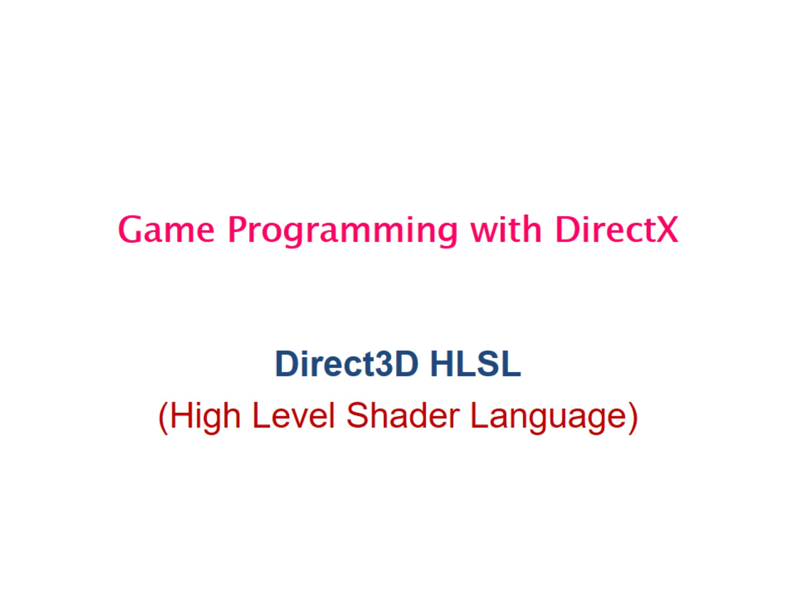
Game Programming with DirectX

Slide 2
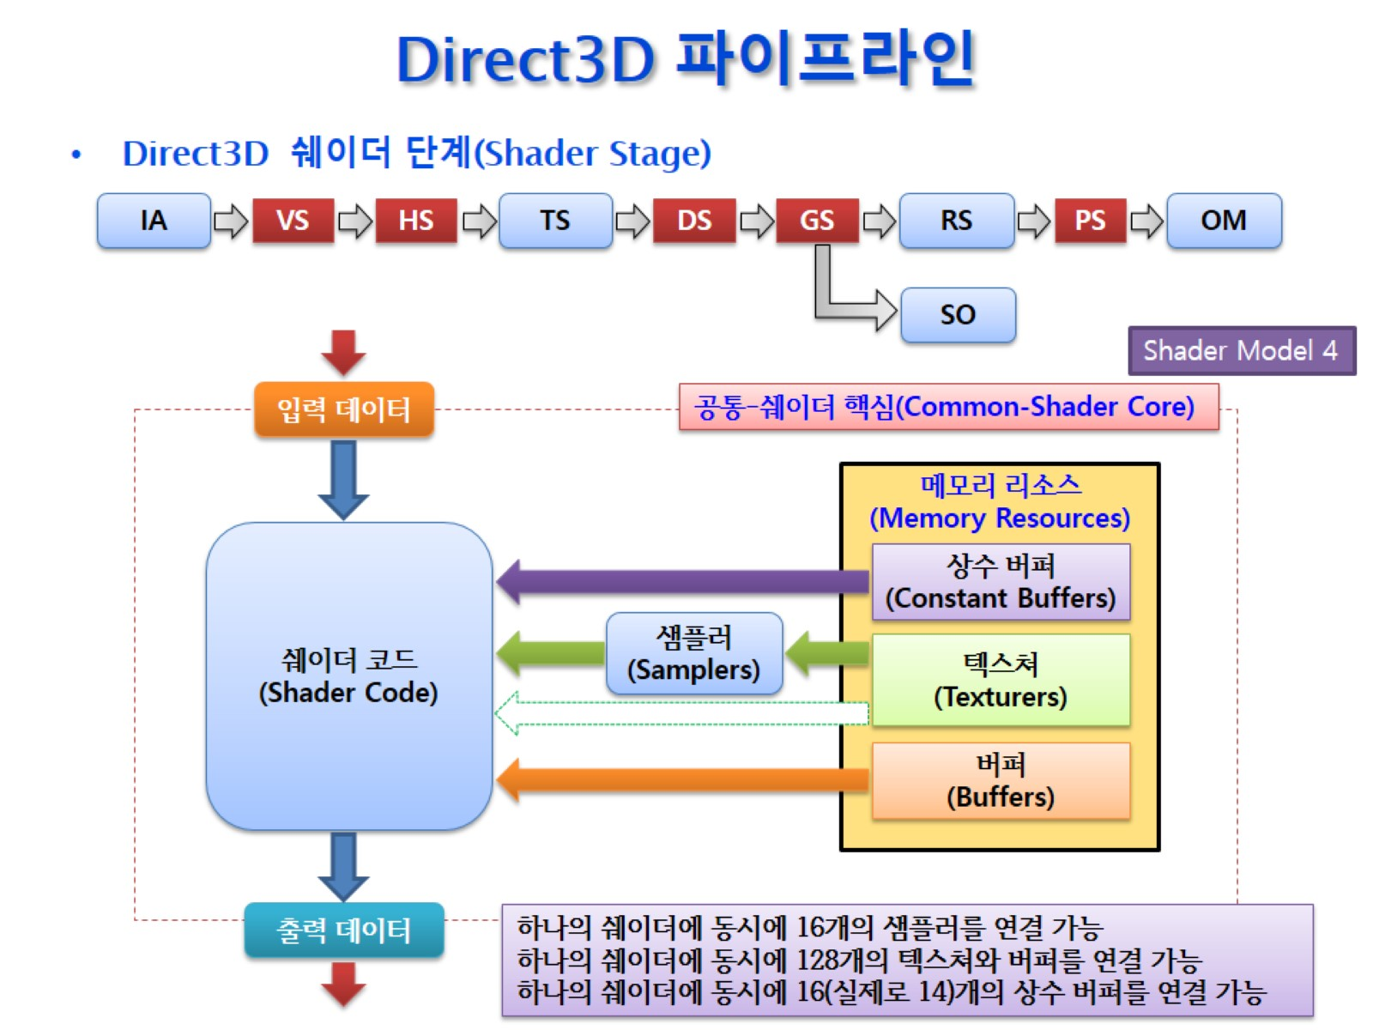
Direct3D 파이프라인

Slide 3
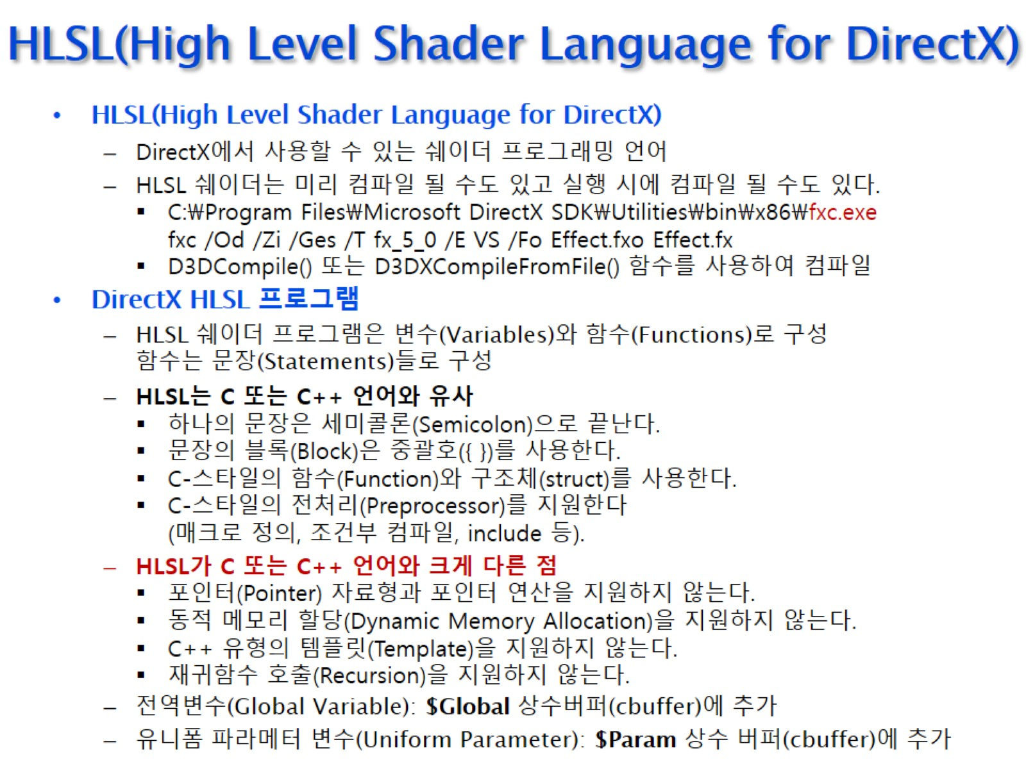
HLSL(High Level Shader Language for DirectX)

Slide 4
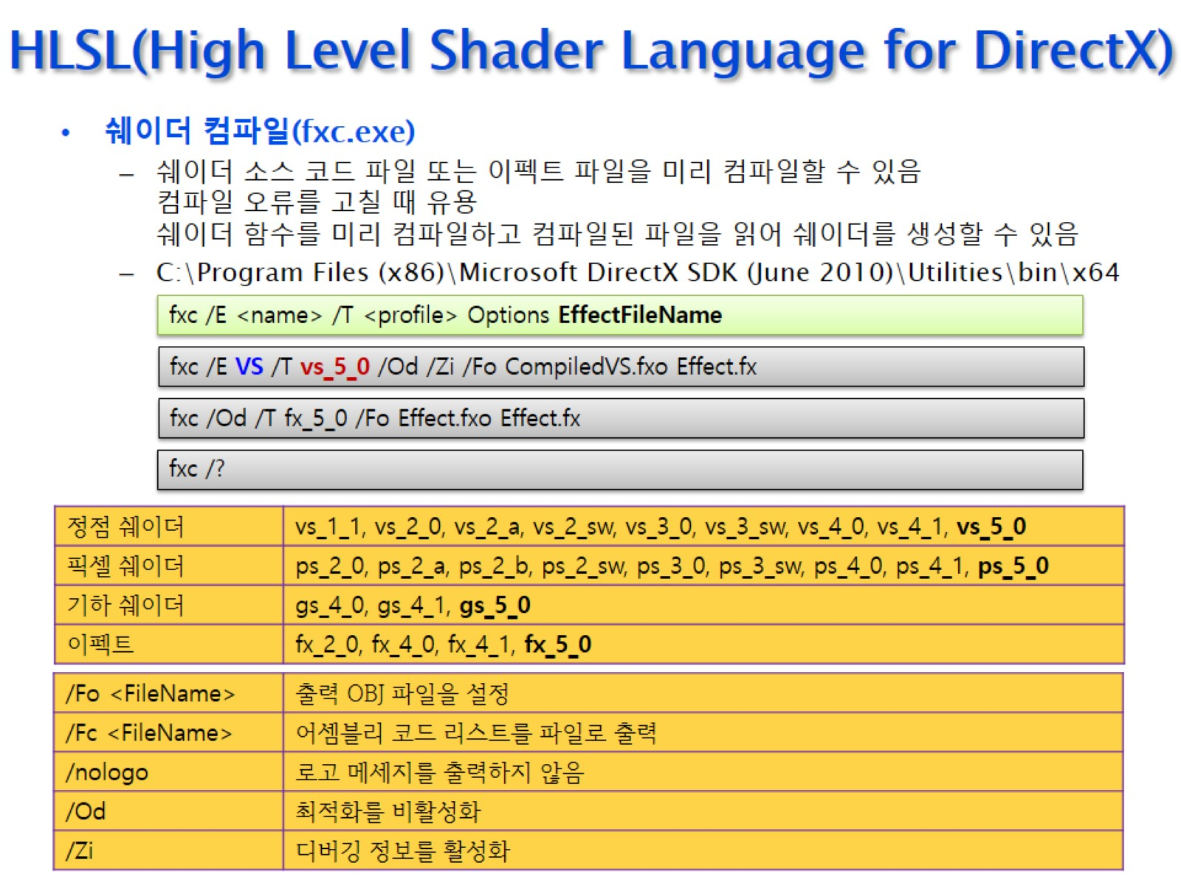
HLSL(High Level Shader Language for DirectX)

Slide 5
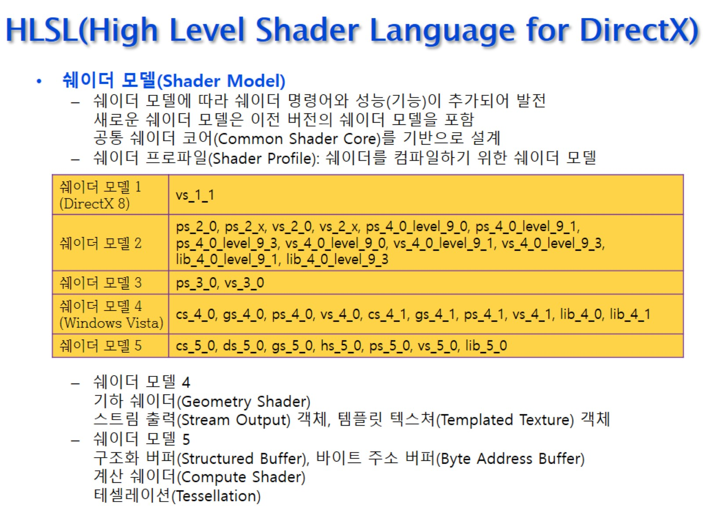
HLSL(High Level Shader Language for DirectX)

Slide 6
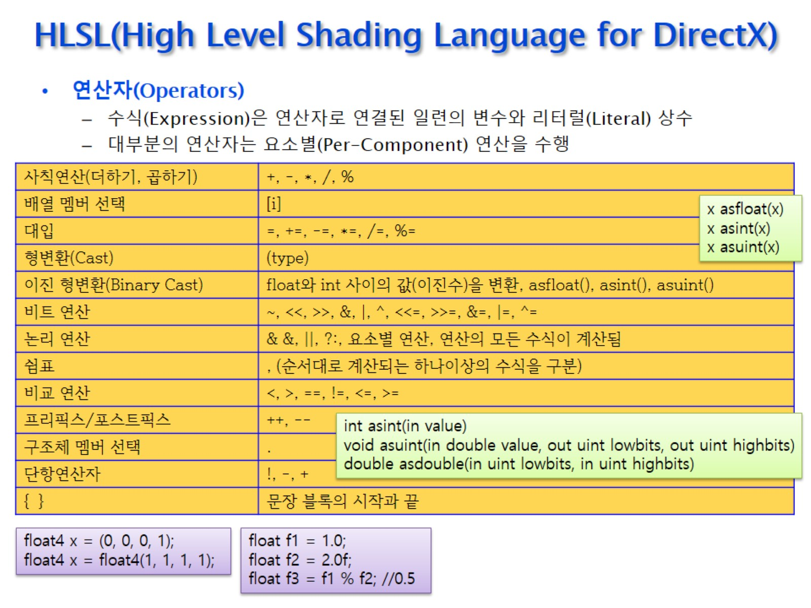
HLSL(High Level Shading Language for DirectX)

Slide 7
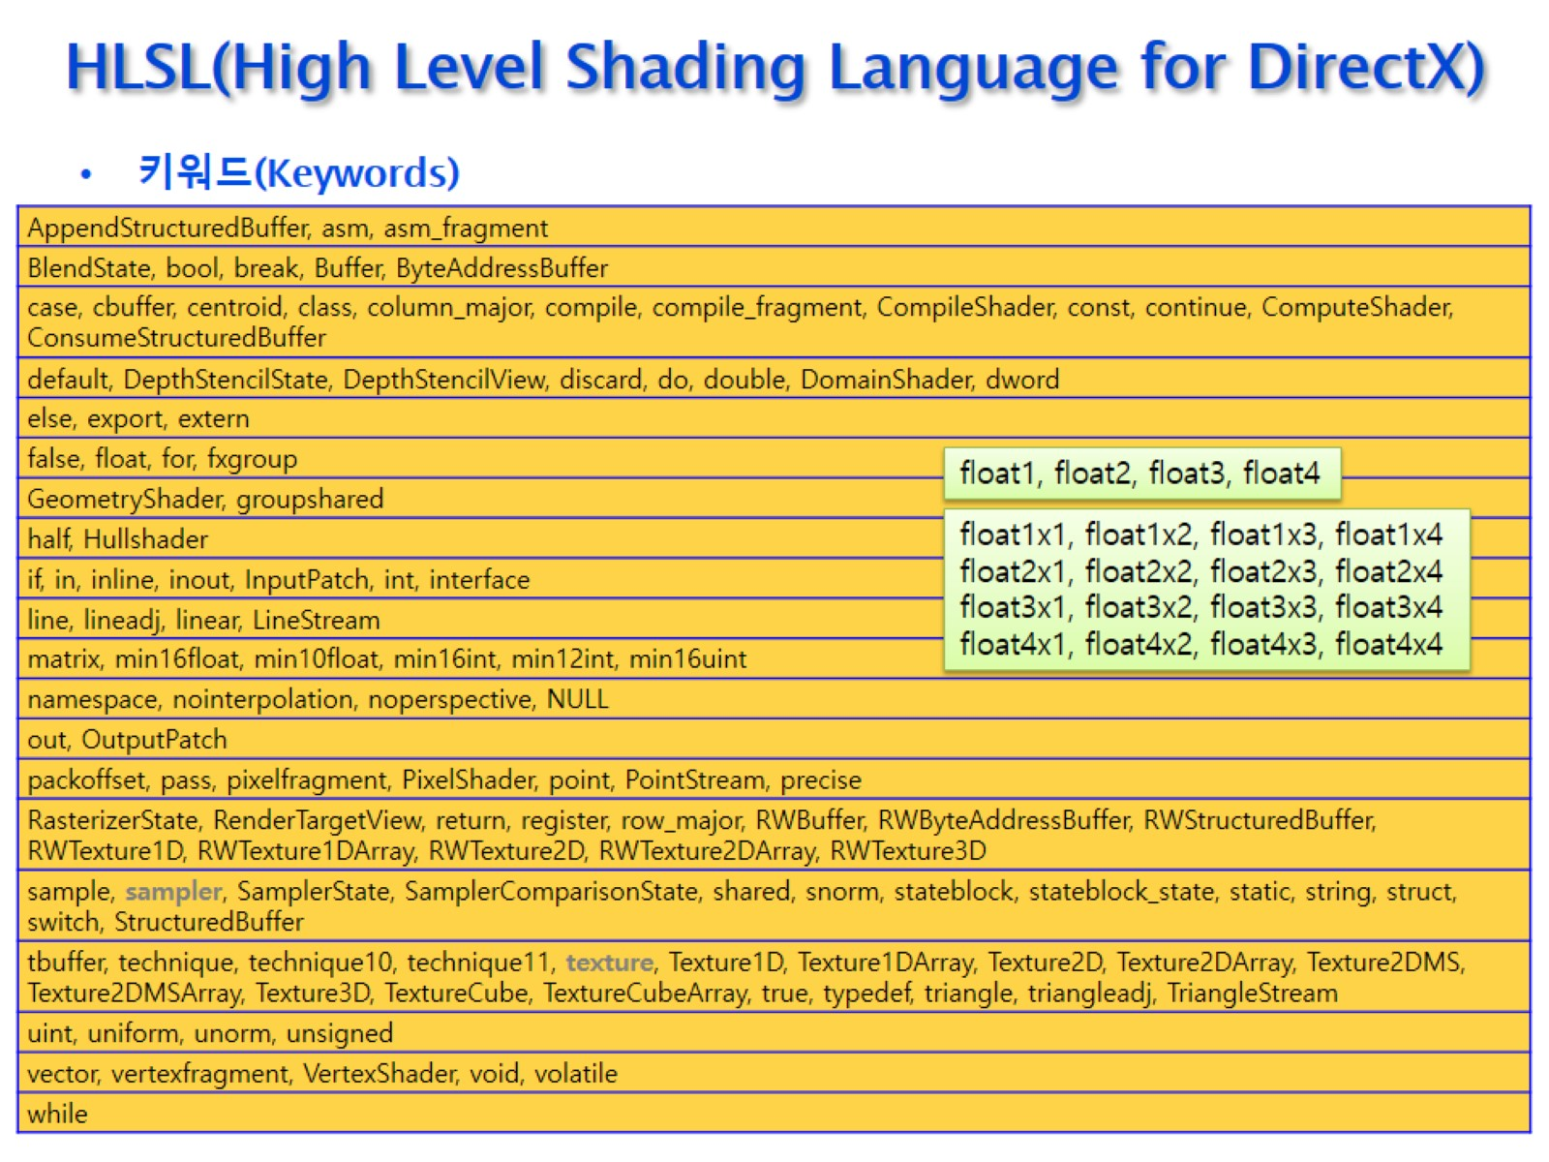
HLSL(High Level Shading Language for DirectX)

Slide 8
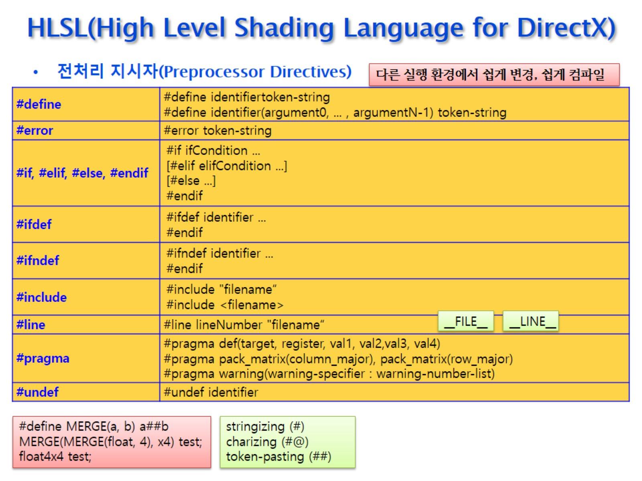
HLSL(High Level Shading Language for DirectX)

Slide 9
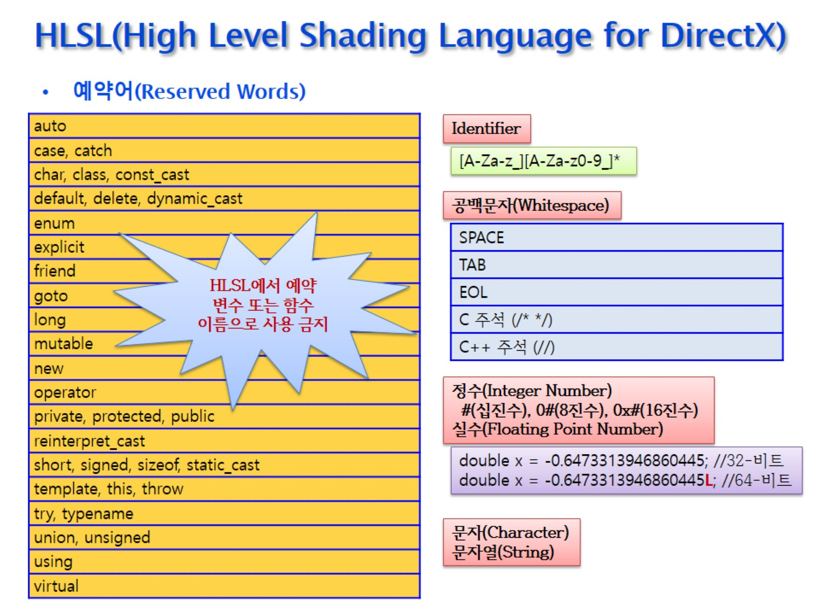
HLSL(High Level Shading Language for DirectX)

Slide 10
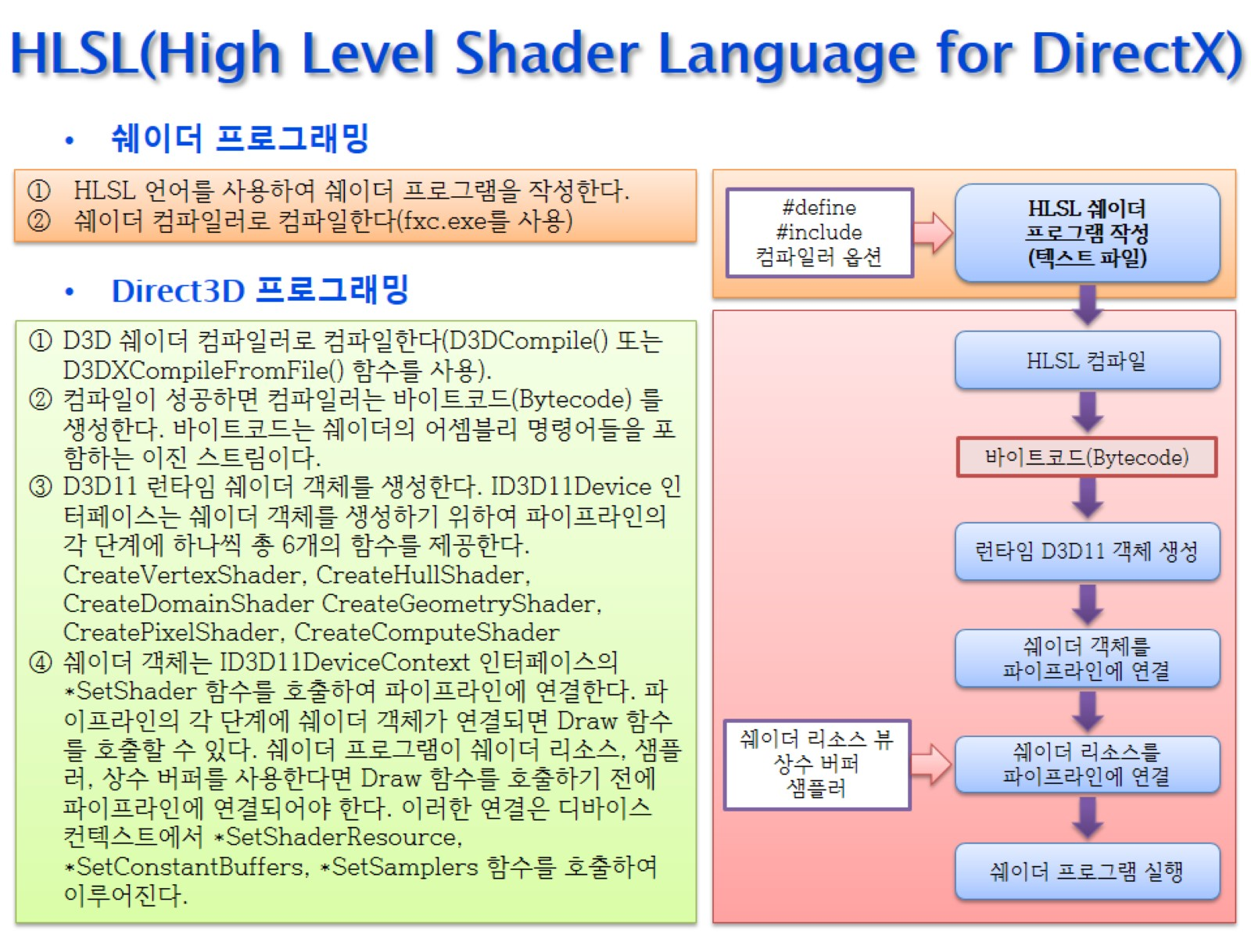
HLSL(High Level Shader Language for DirectX)

Slide 11
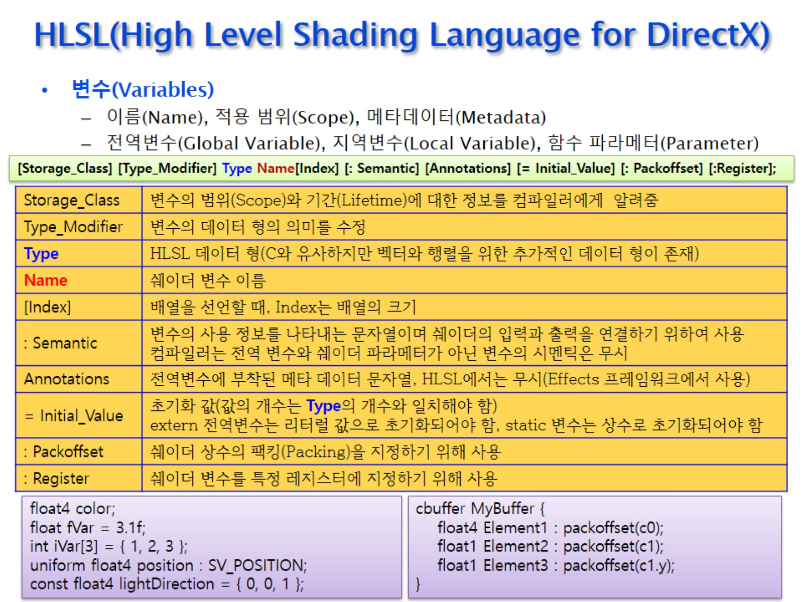
HLSL(High Level Shading Language for DirectX)

Slide 12
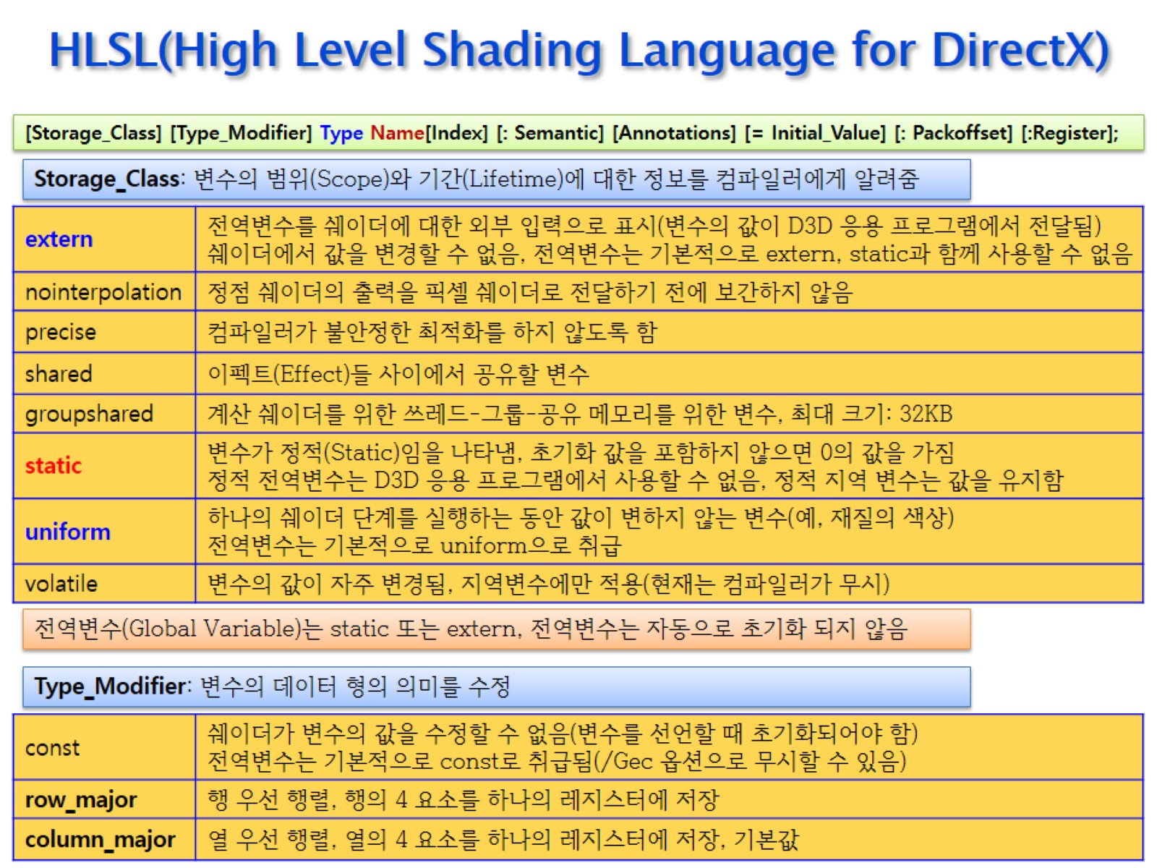
HLSL(High Level Shading Language for DirectX)

Slide 13
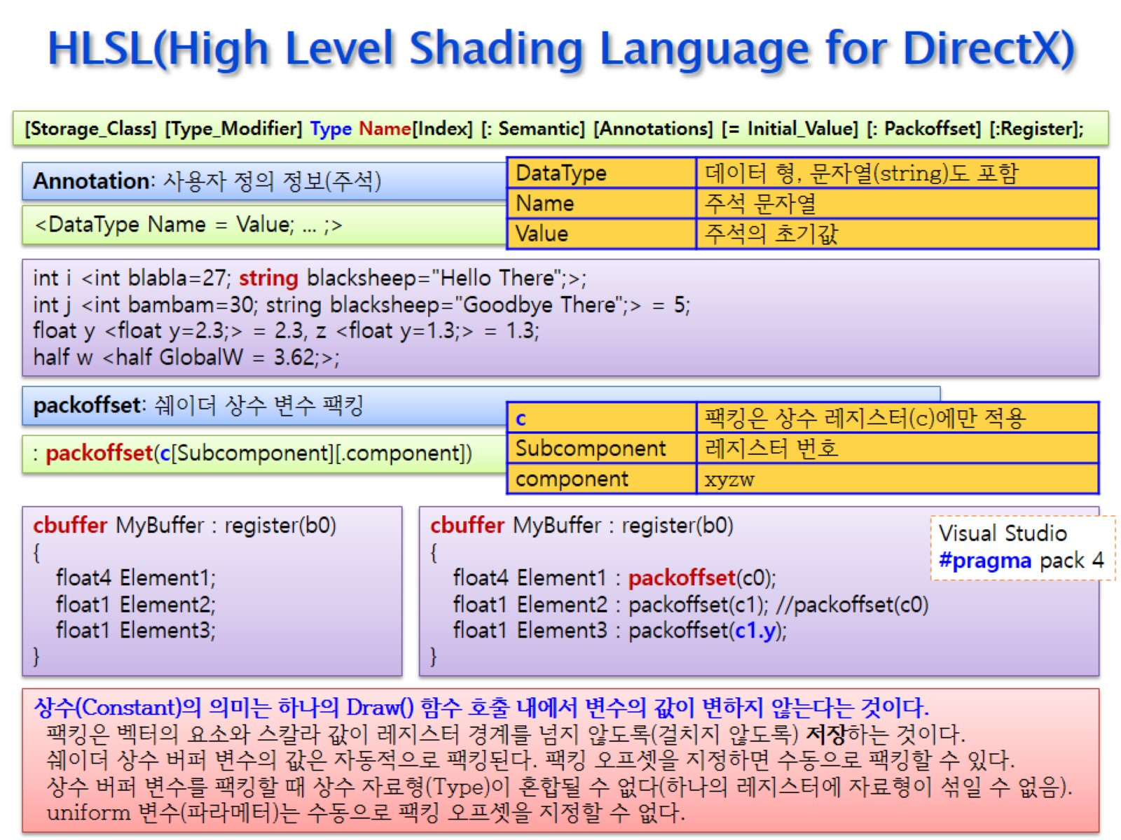
HLSL(High Level Shading Language for DirectX)

Slide 14
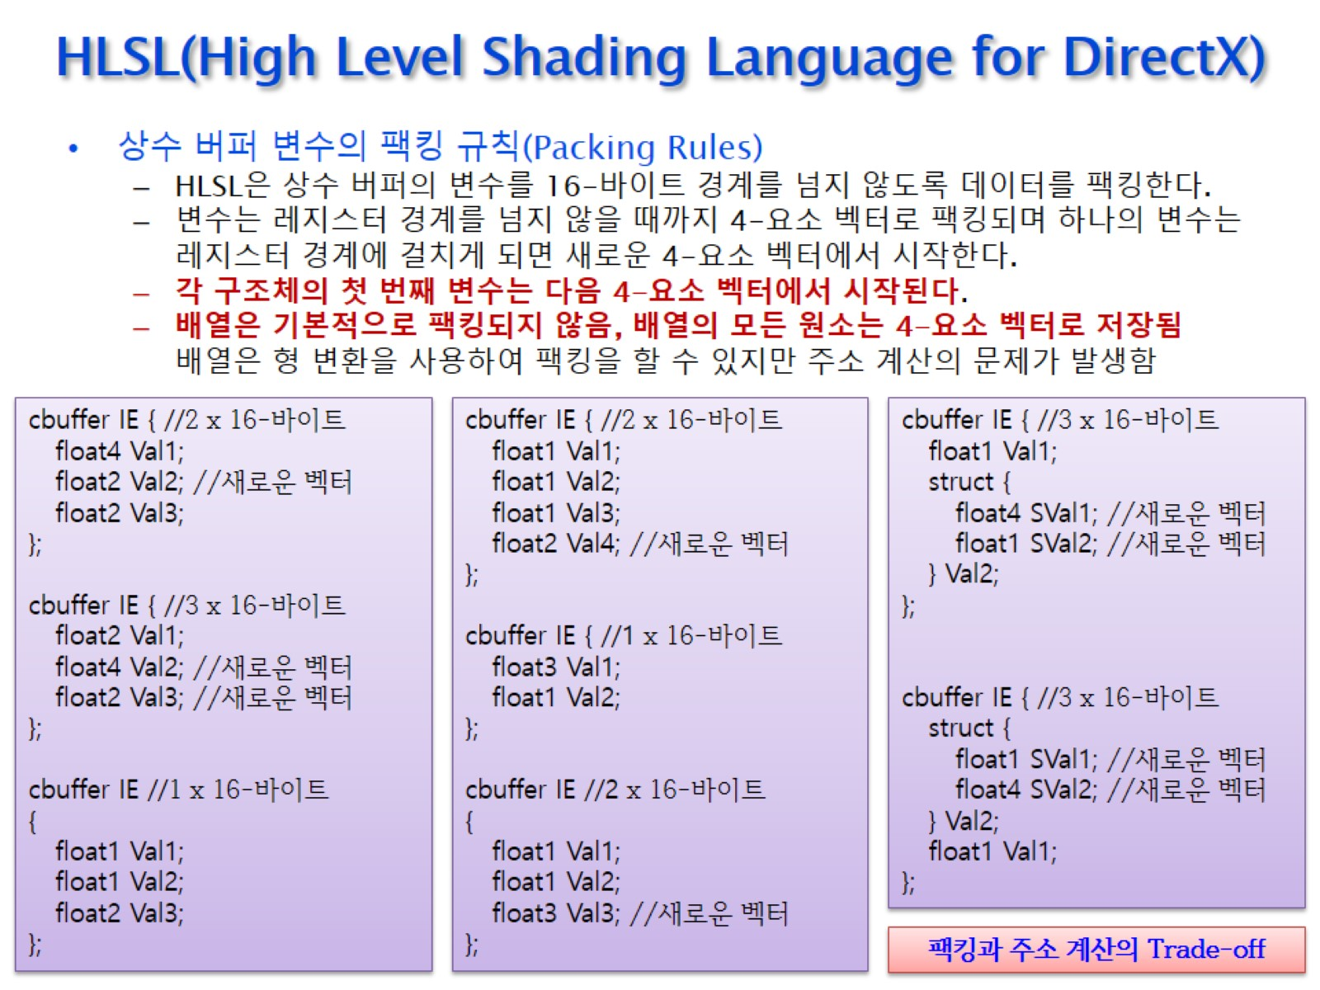
HLSL(High Level Shading Language for DirectX)

Slide 15
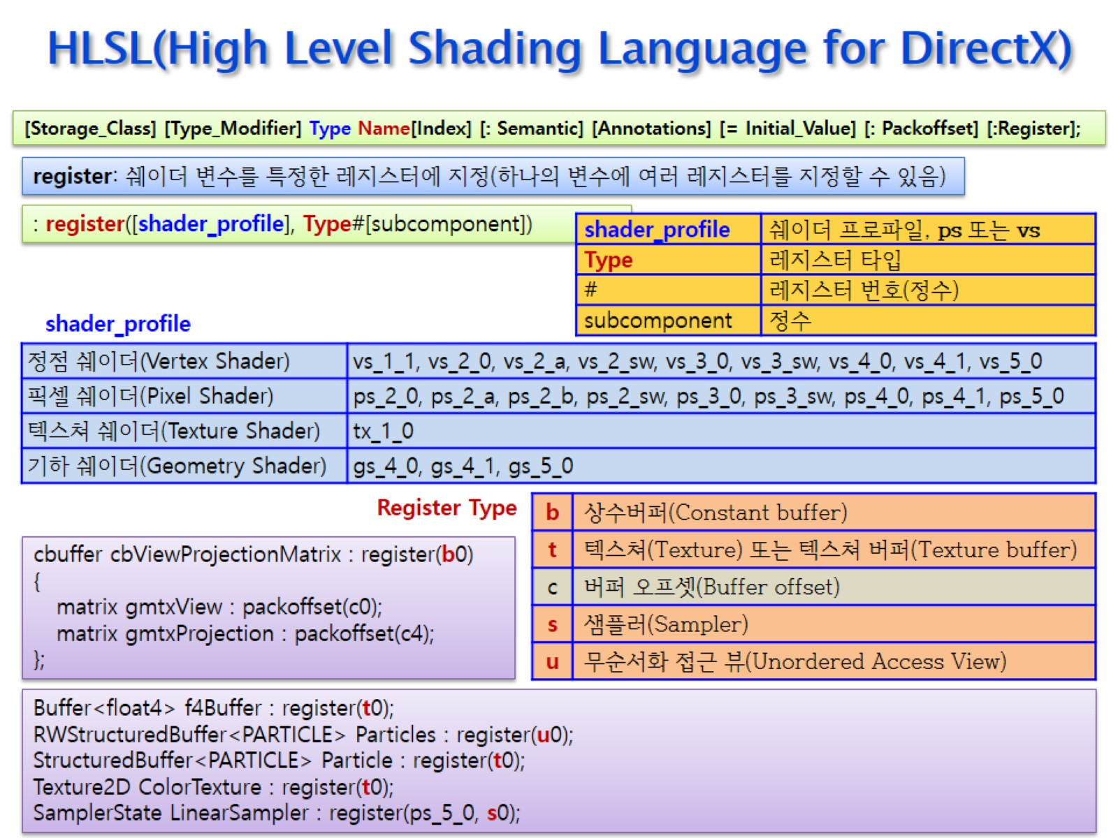
HLSL(High Level Shading Language for DirectX)

Slide 16
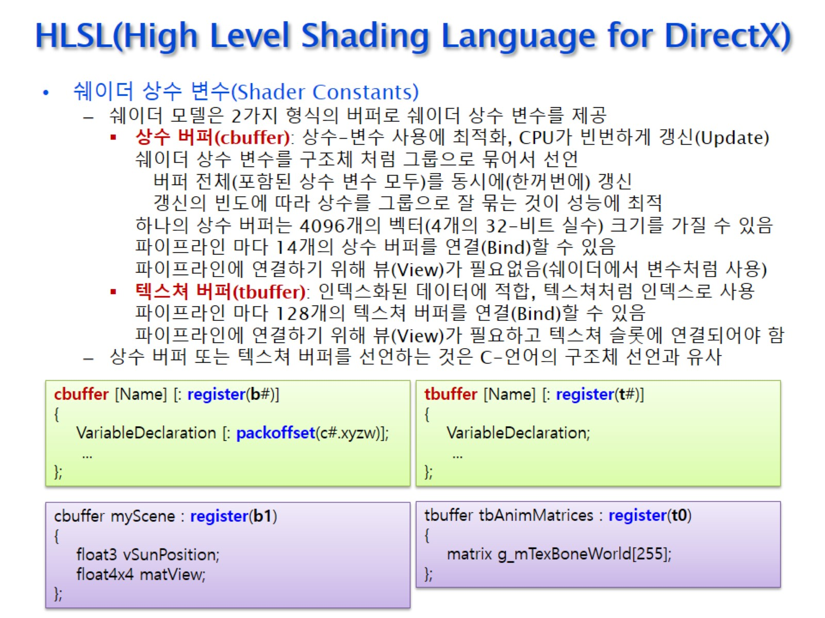
HLSL(High Level Shading Language for DirectX)

Slide 17
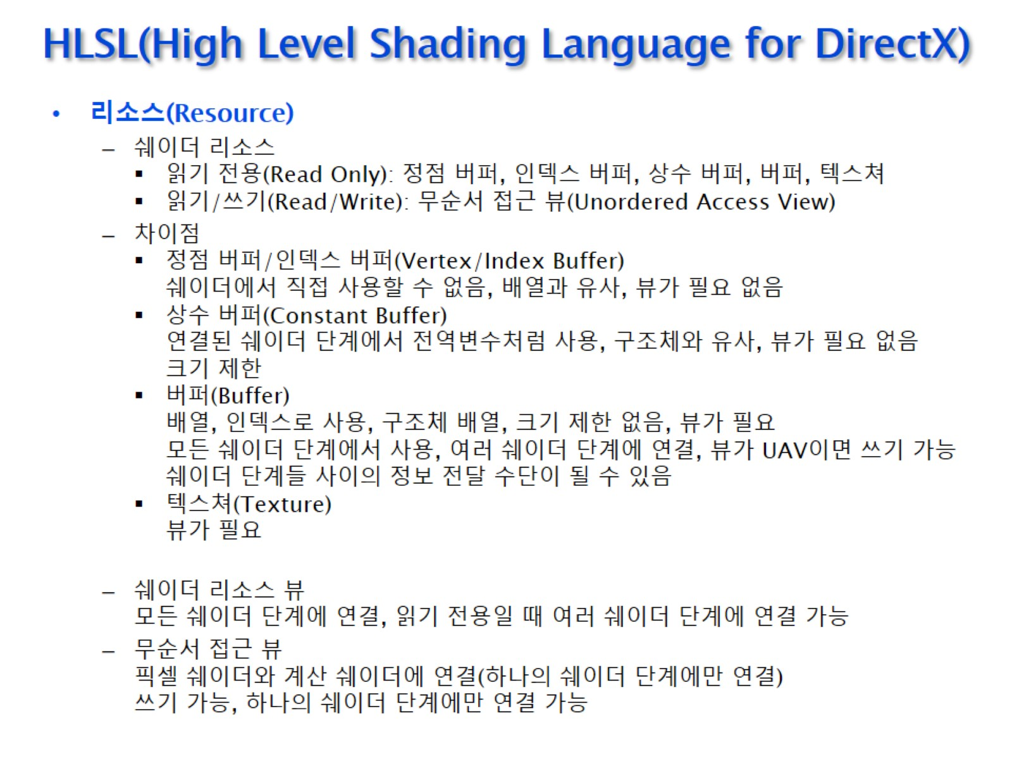
HLSL(High Level Shading Language for DirectX)

Slide 18
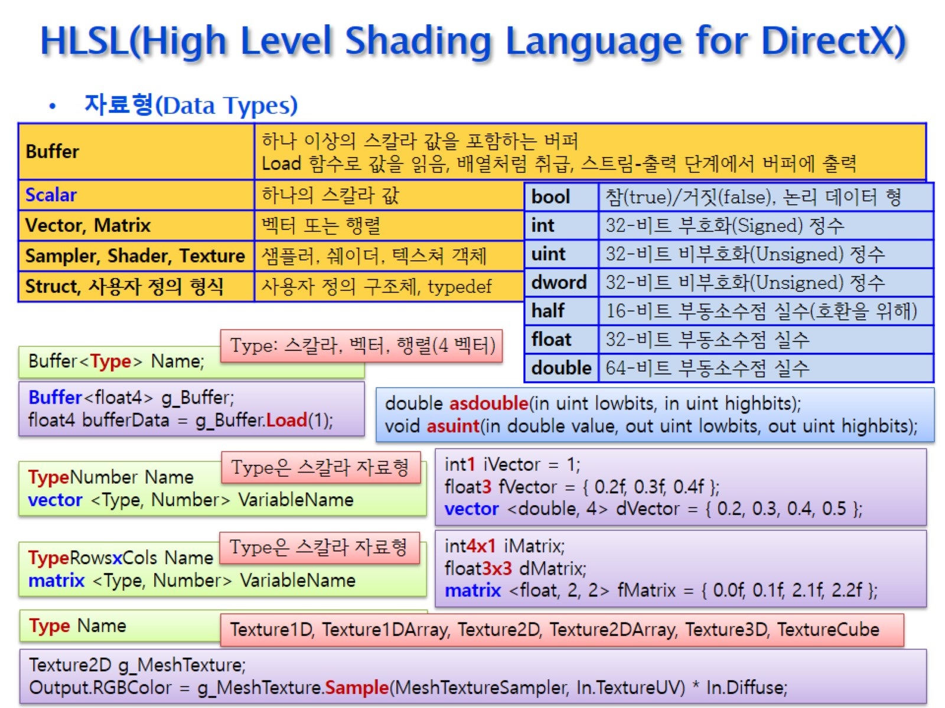
HLSL(High Level Shading Language for DirectX)

Slide 19
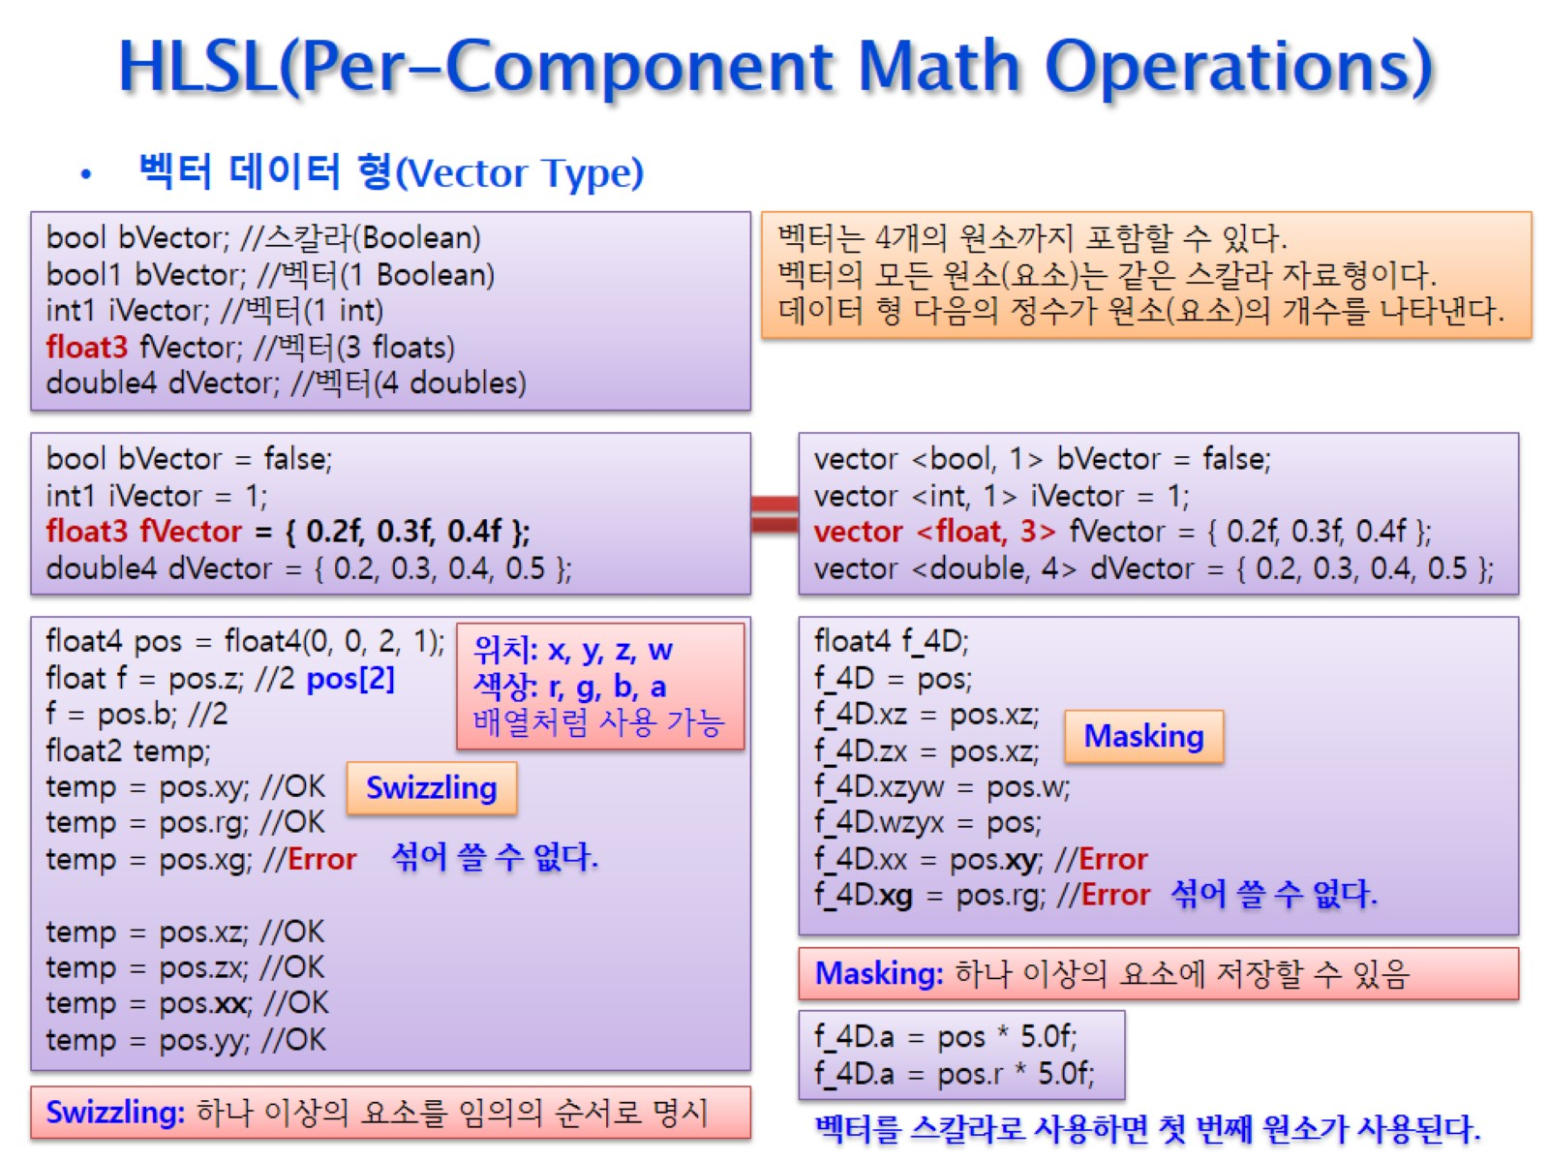
HLSL(Per-Component Math Operations)

Slide 20
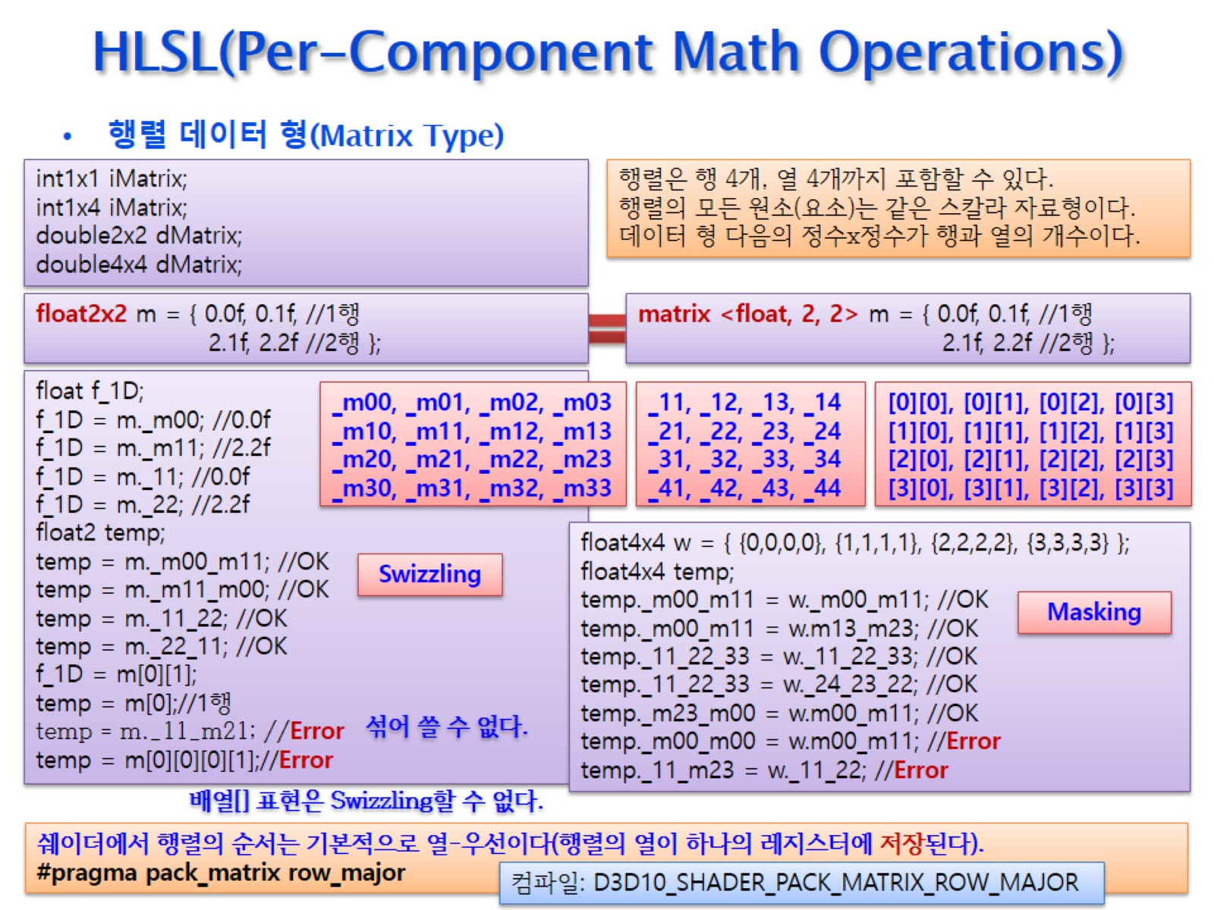
HLSL(Per-Component Math Operations)

Slide 21
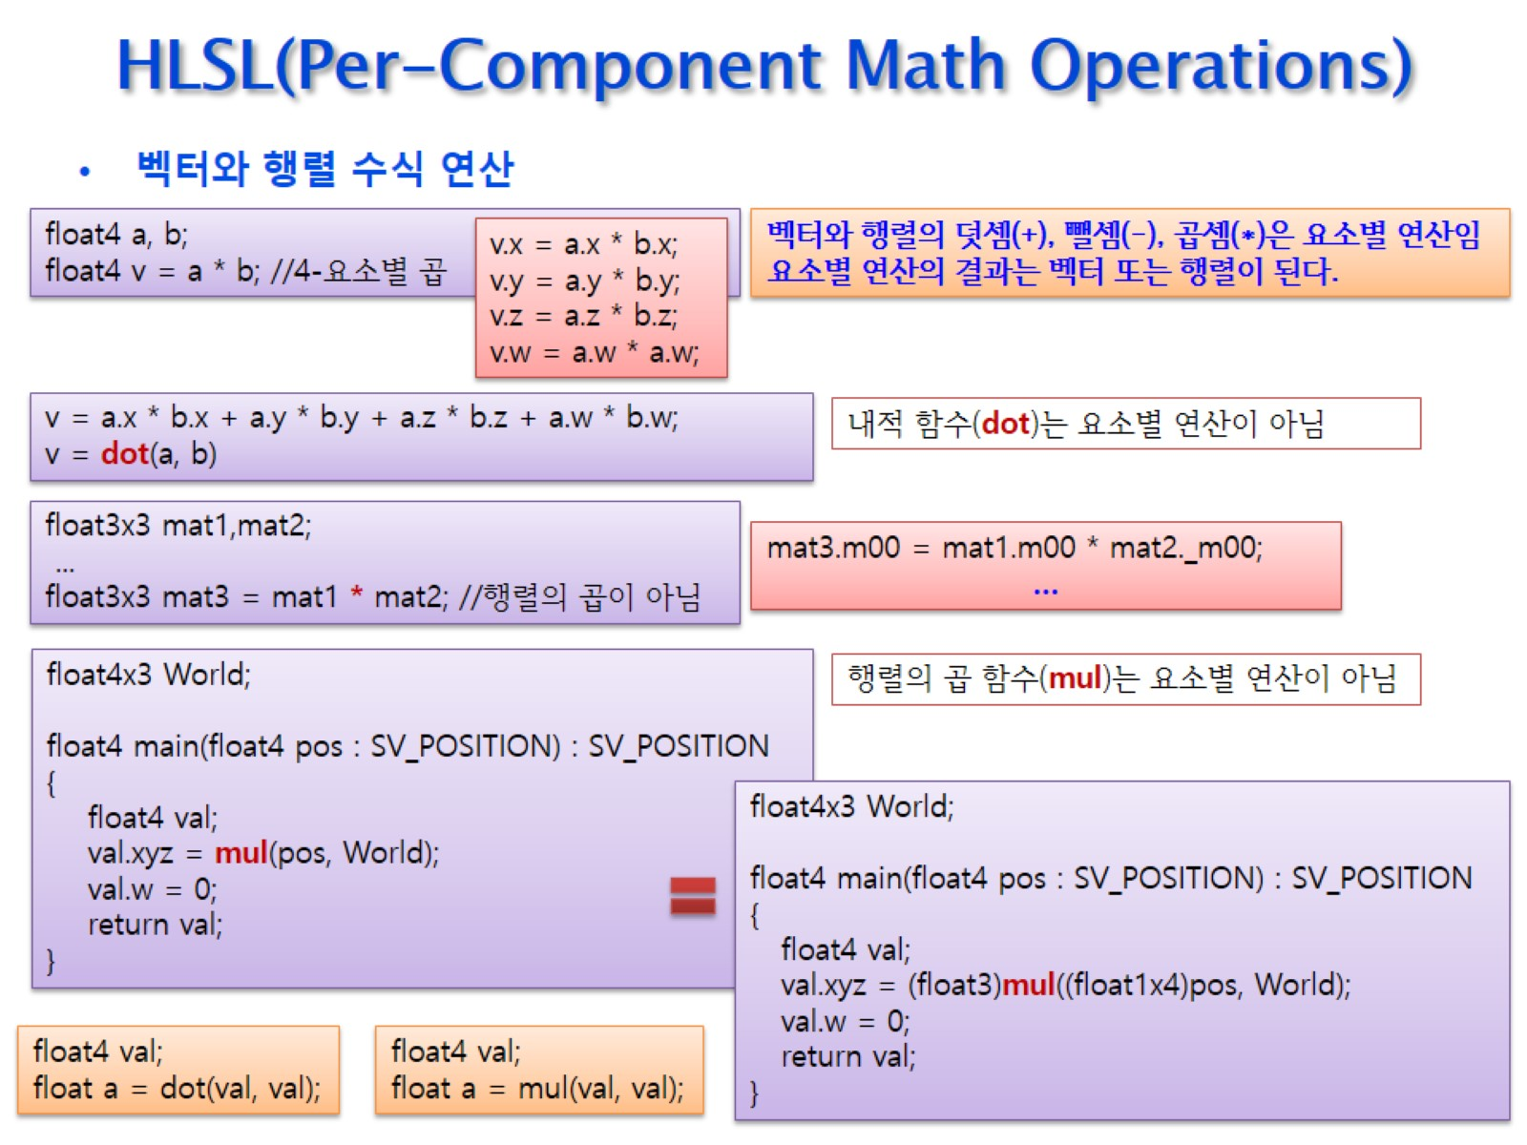
HLSL(Per-Component Math Operations)

Slide 22
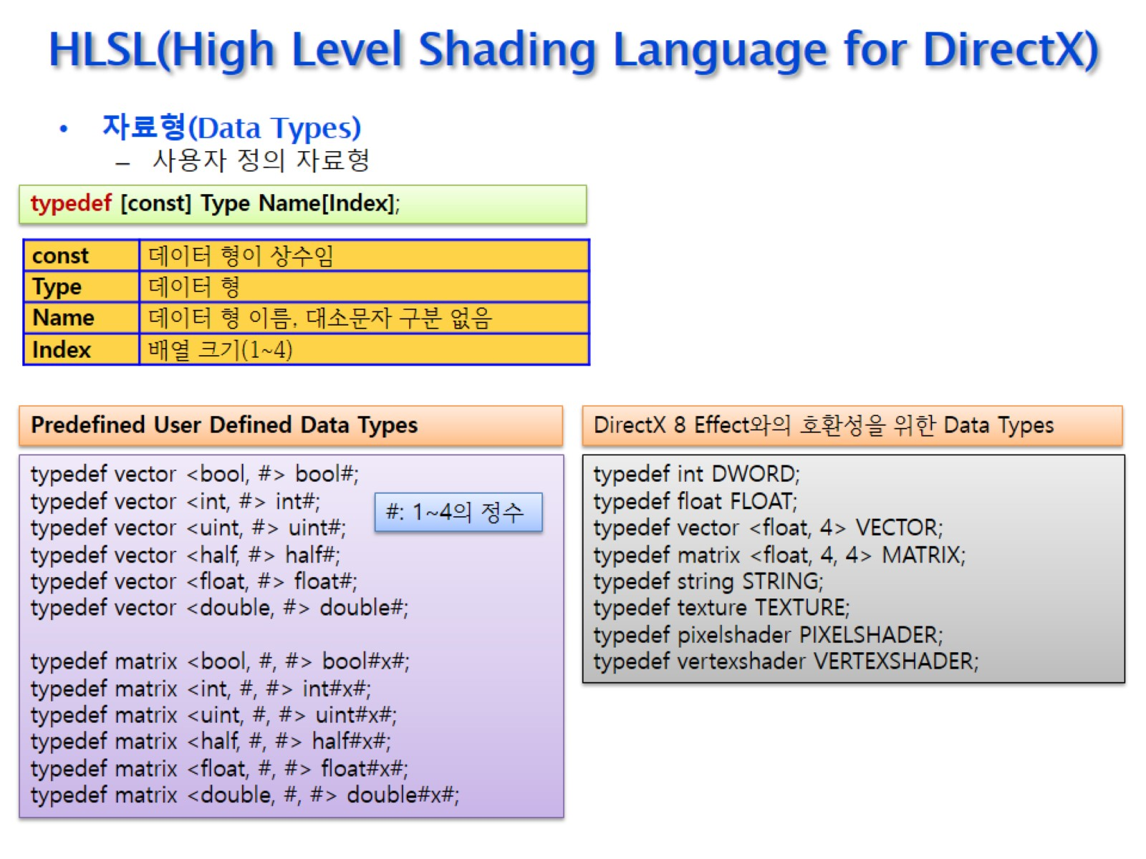
HLSL(High Level Shading Language for DirectX)

Slide 23
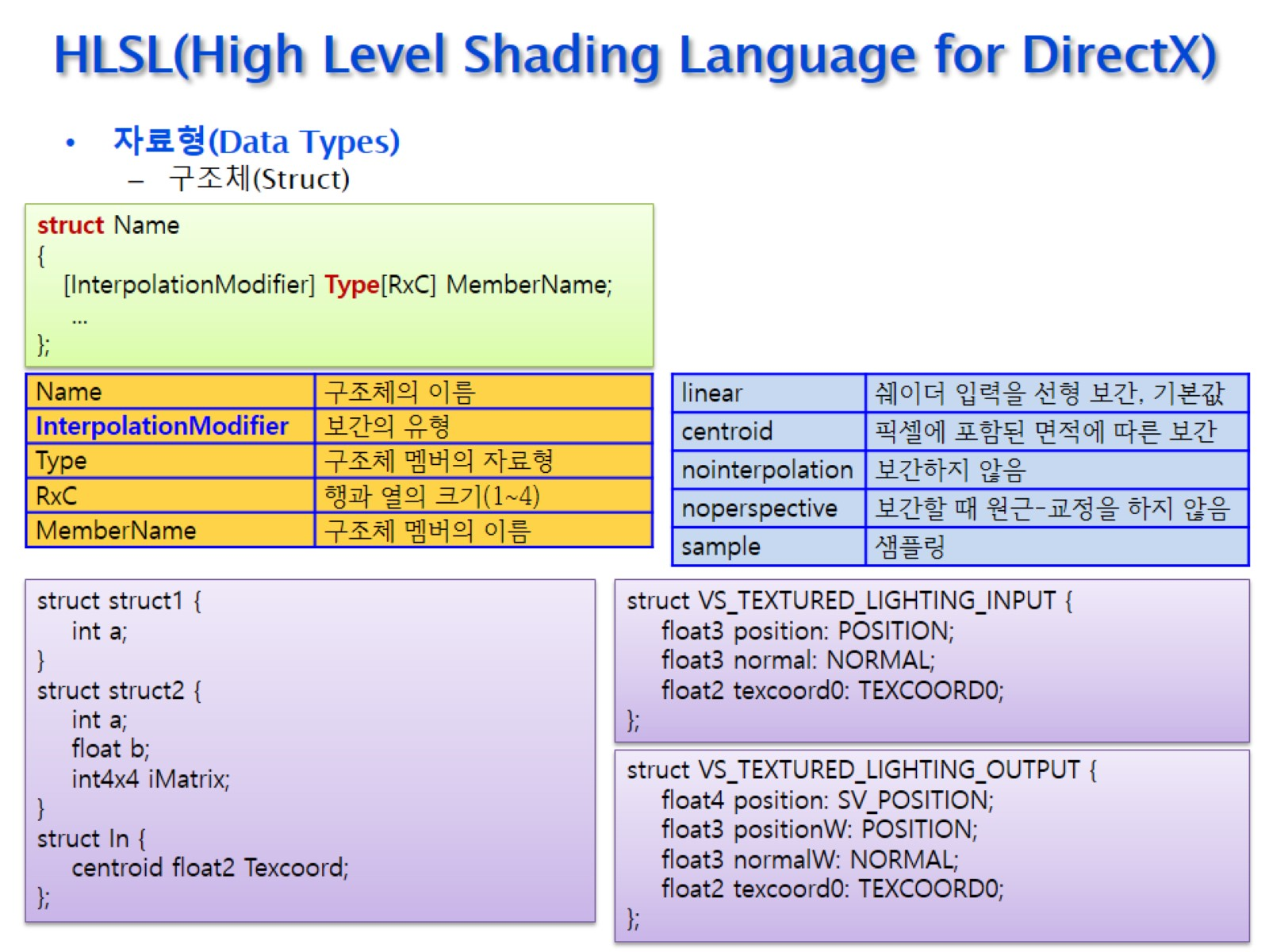
HLSL(High Level Shading Language for DirectX)

Slide 24
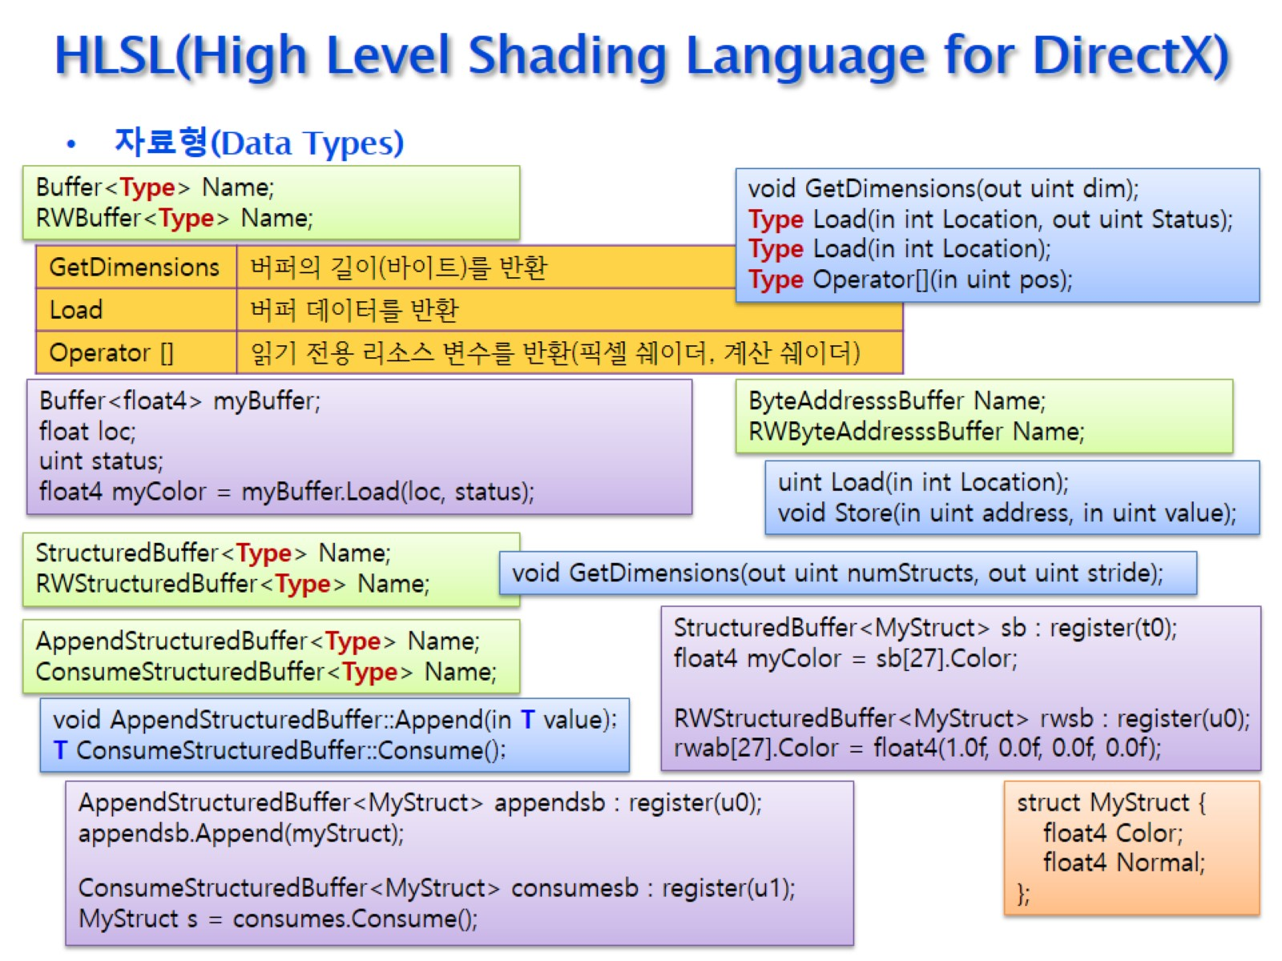
HLSL(High Level Shading Language for DirectX)

Slide 25
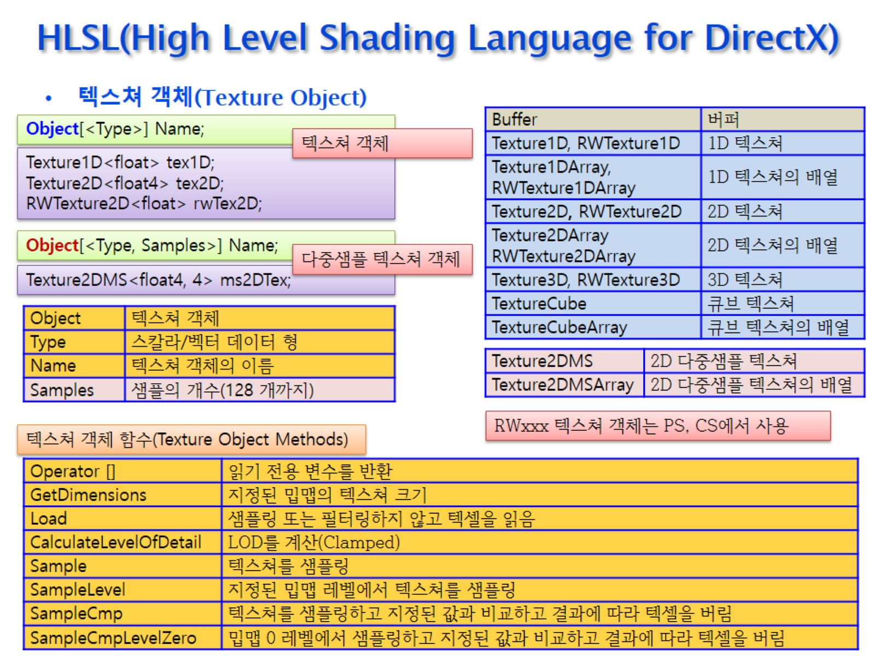
HLSL(High Level Shading Language for DirectX)

Slide 26
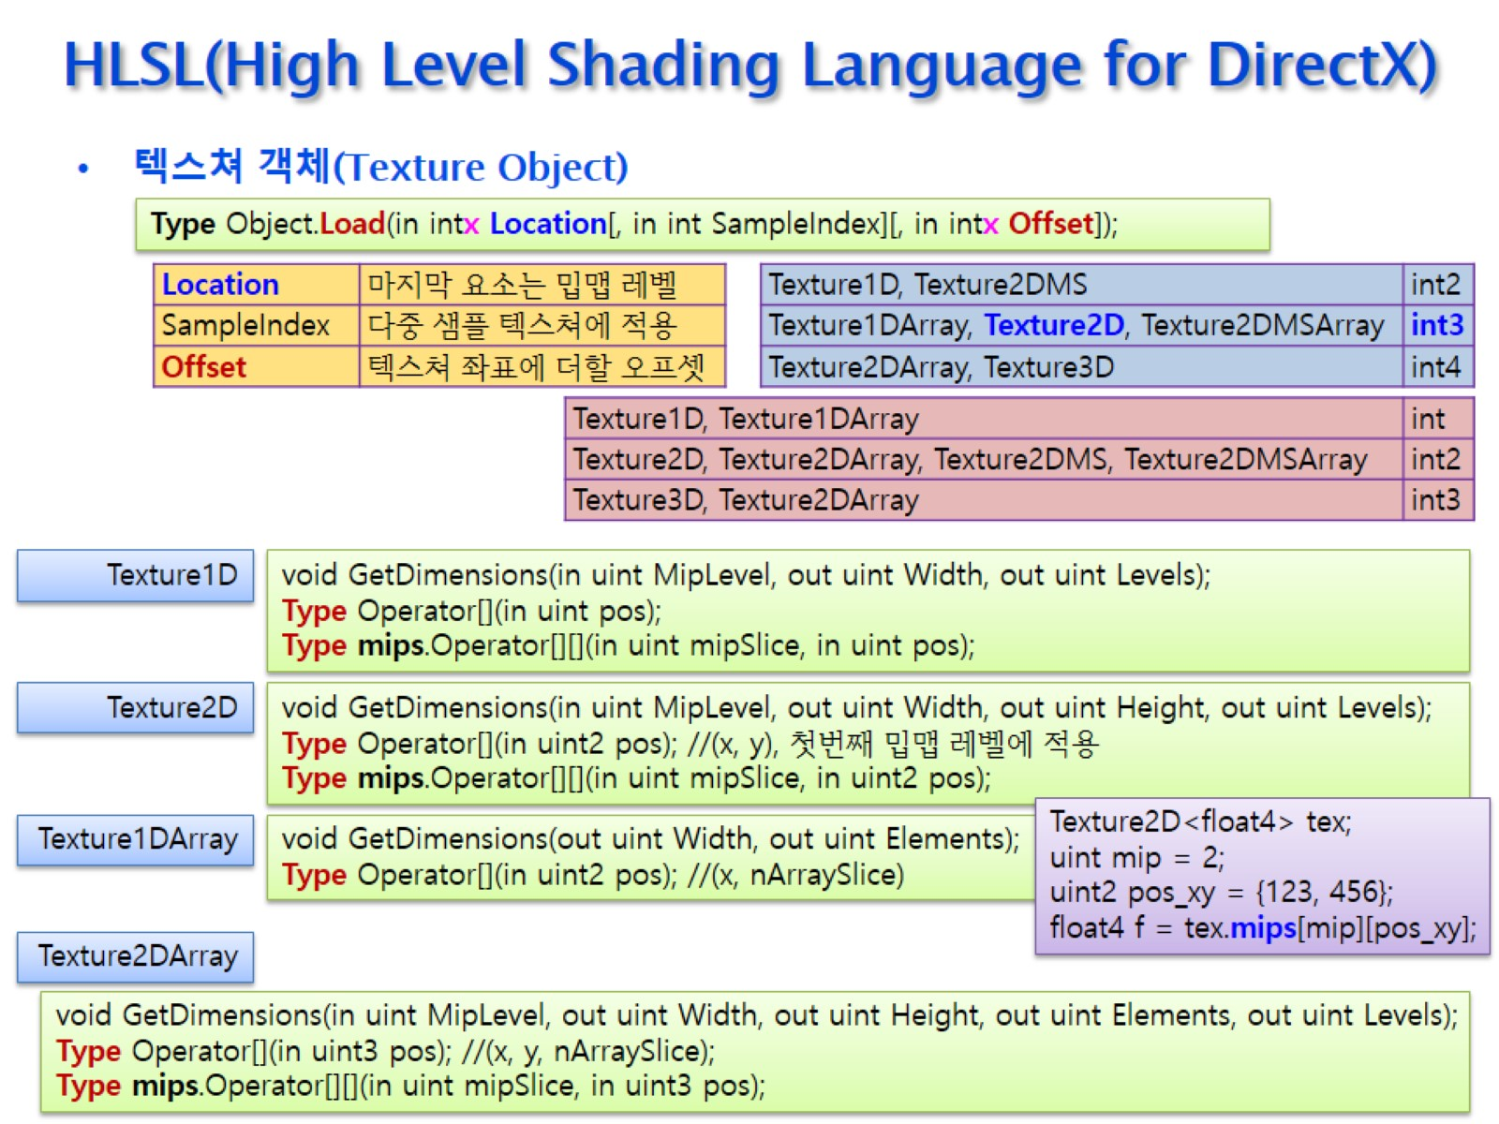
HLSL(High Level Shading Language for DirectX)

Slide 27
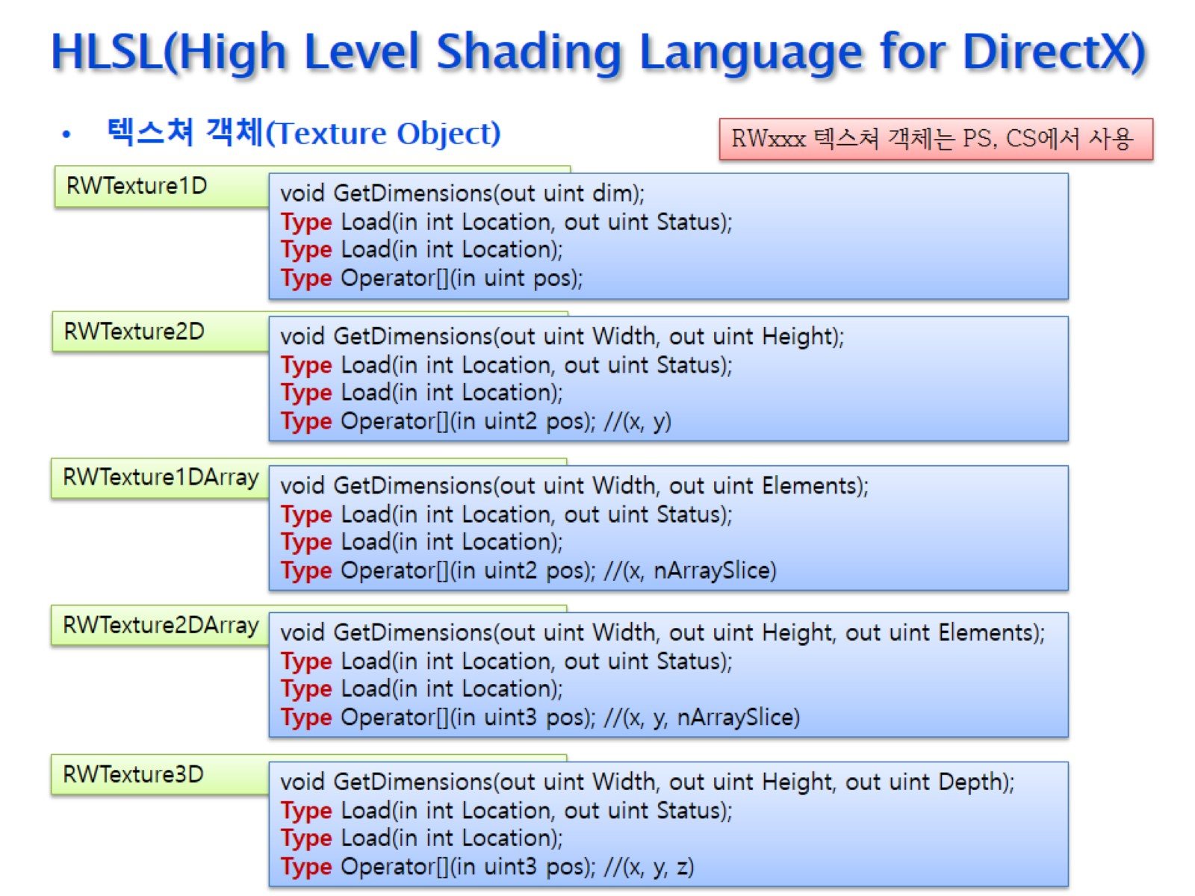
HLSL(High Level Shading Language for DirectX)

Slide 28
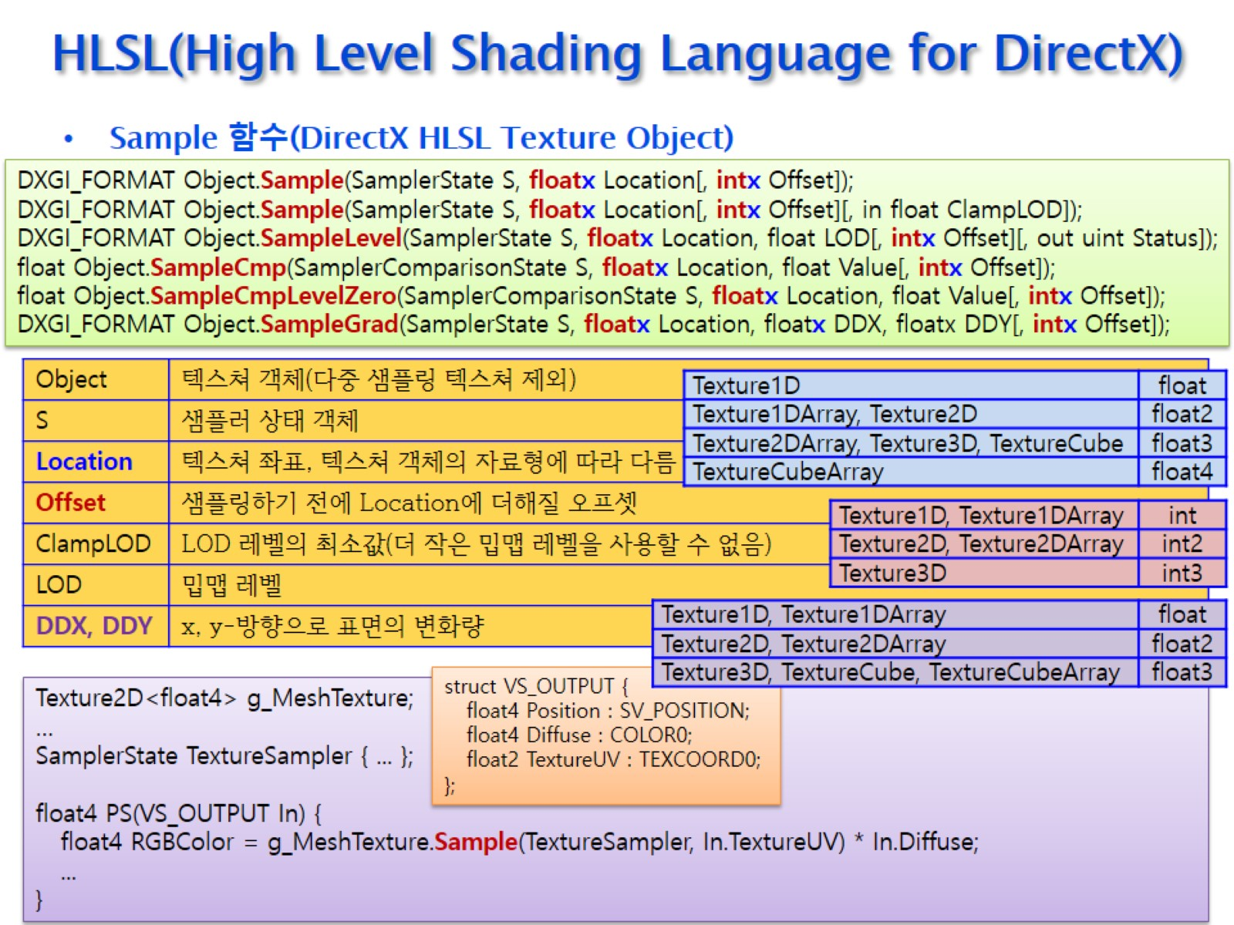
HLSL(High Level Shading Language for DirectX)

Slide 29
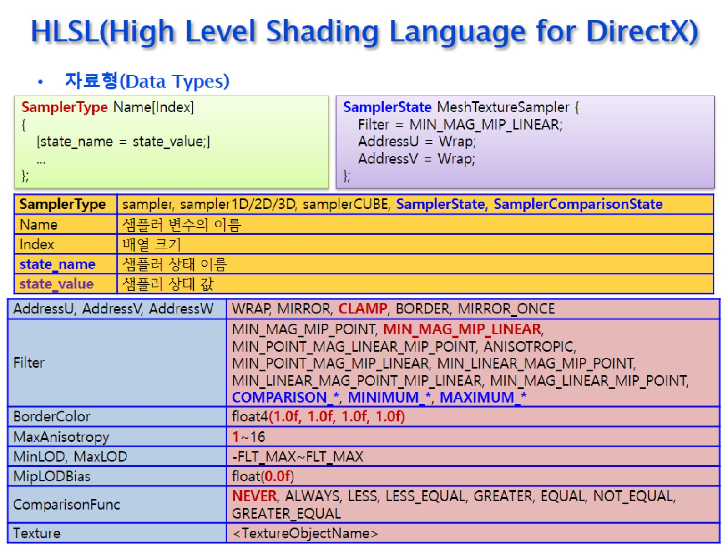
HLSL(High Level Shading Language for DirectX)

Slide 30
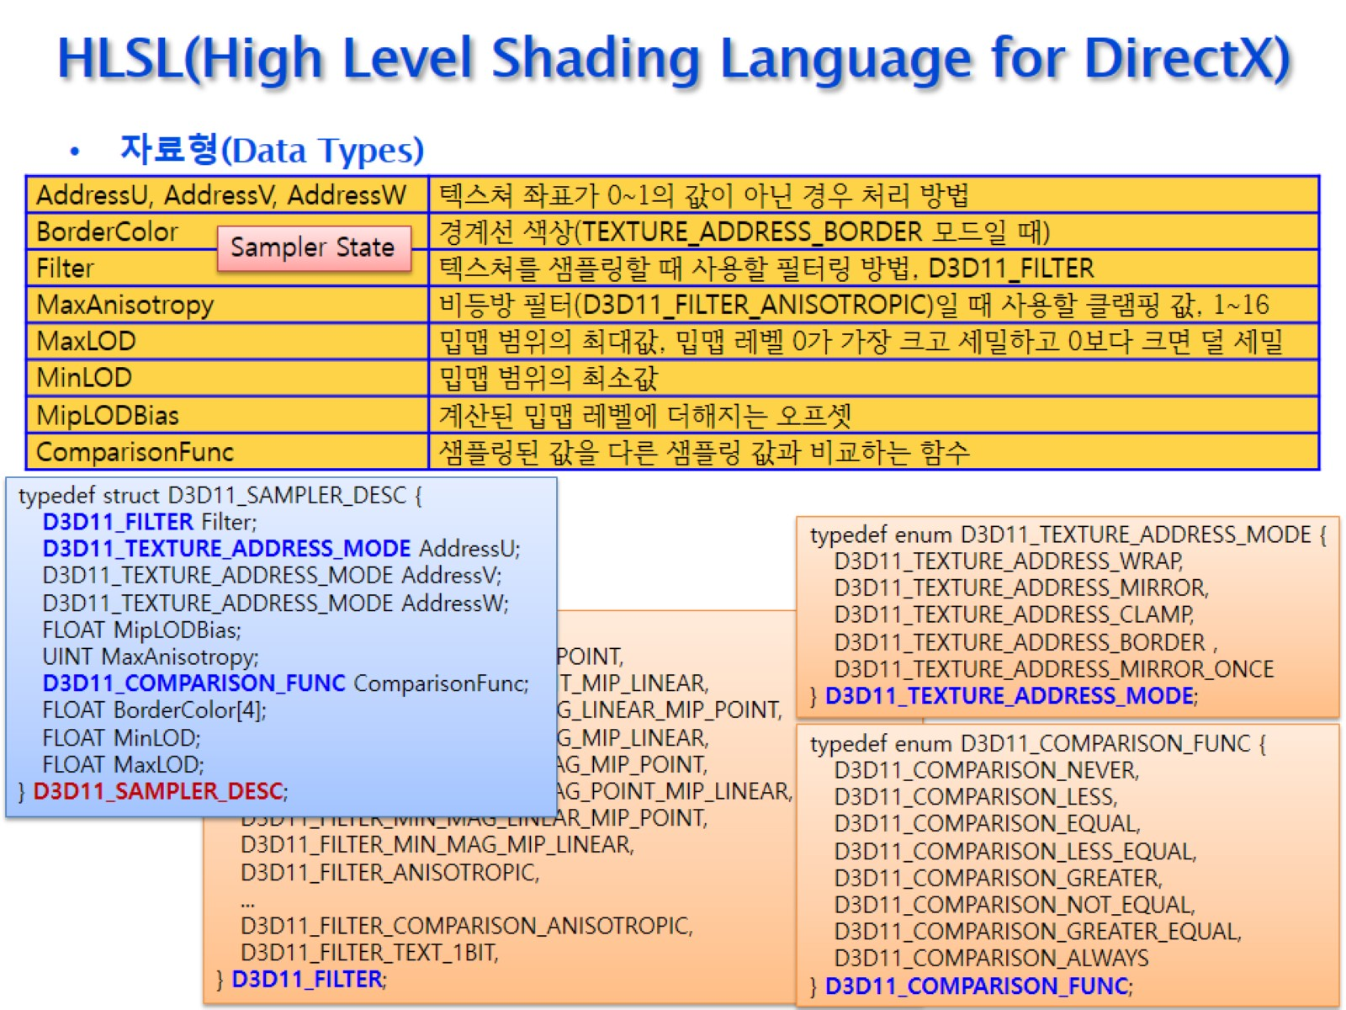
HLSL(High Level Shading Language for DirectX)

Slide 31
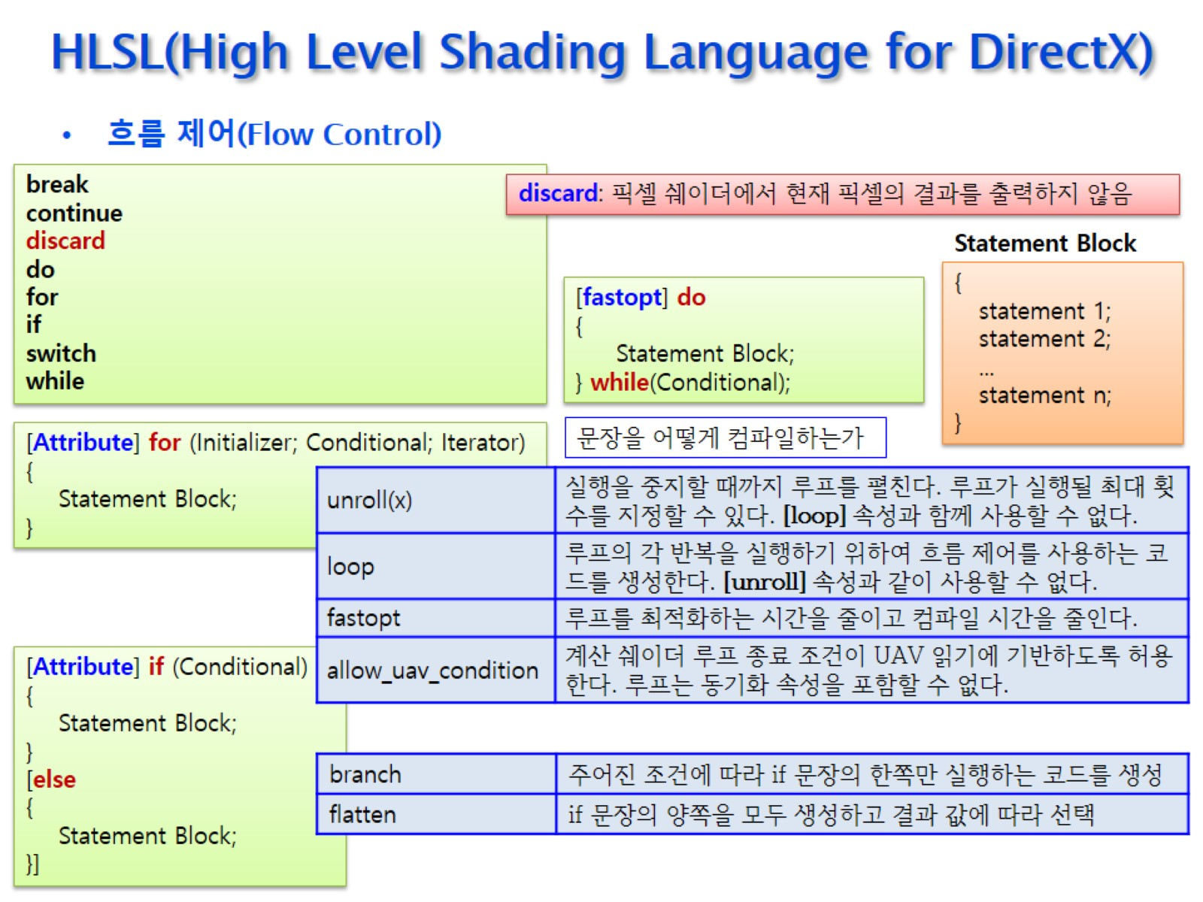
HLSL(High Level Shading Language for DirectX)

Slide 32
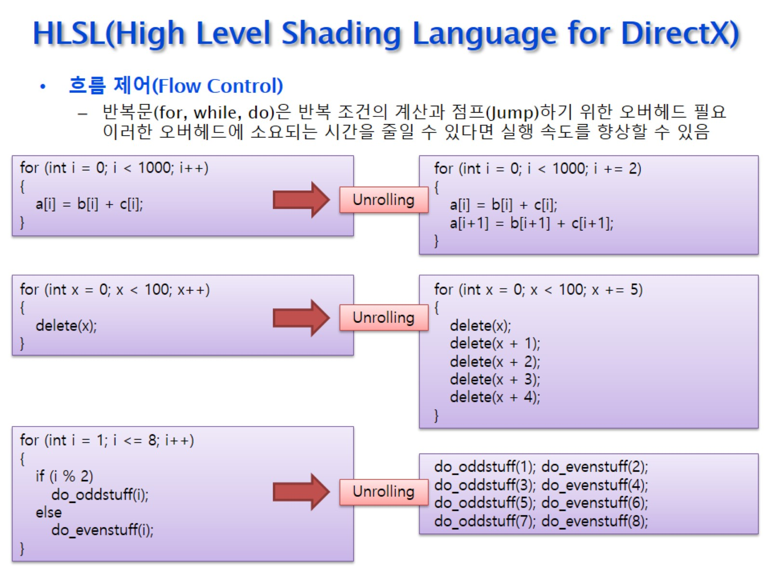
HLSL(High Level Shading Language for DirectX)

Slide 33
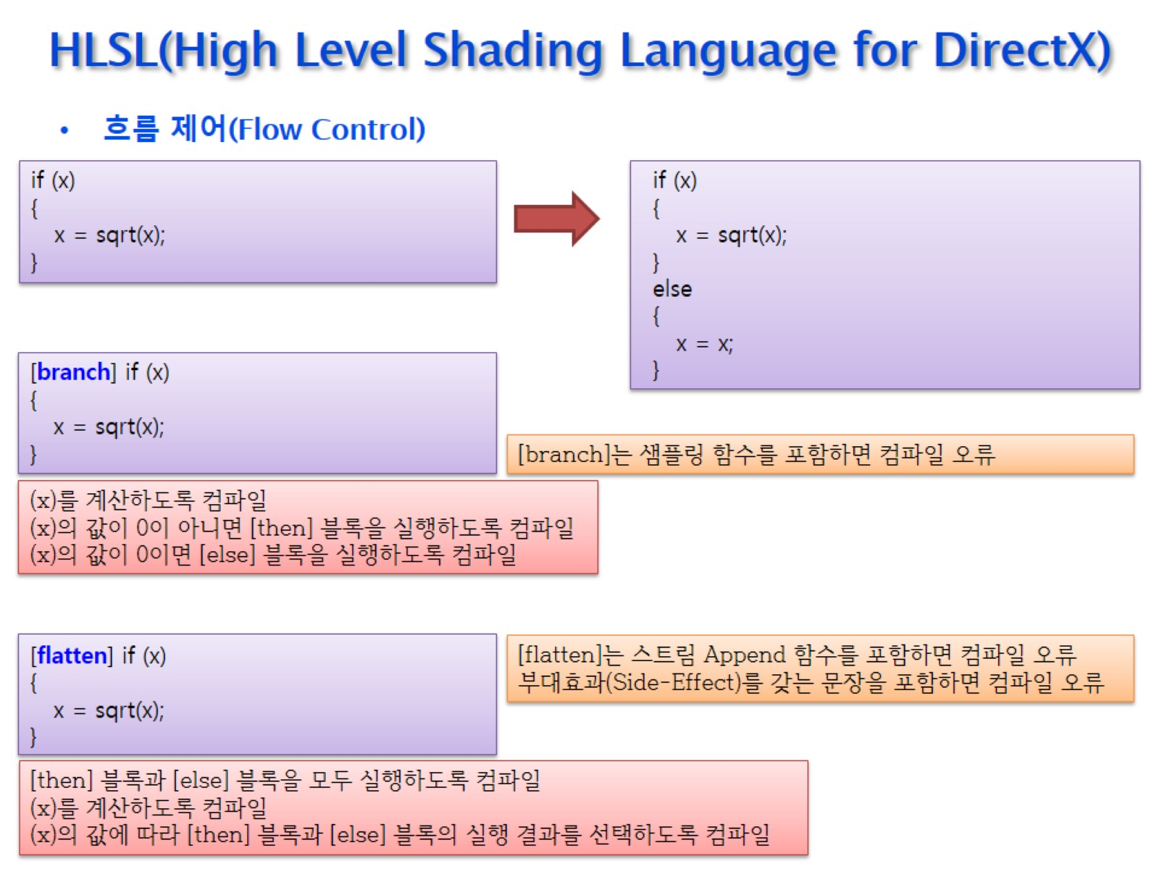
HLSL(High Level Shading Language for DirectX)

Slide 34
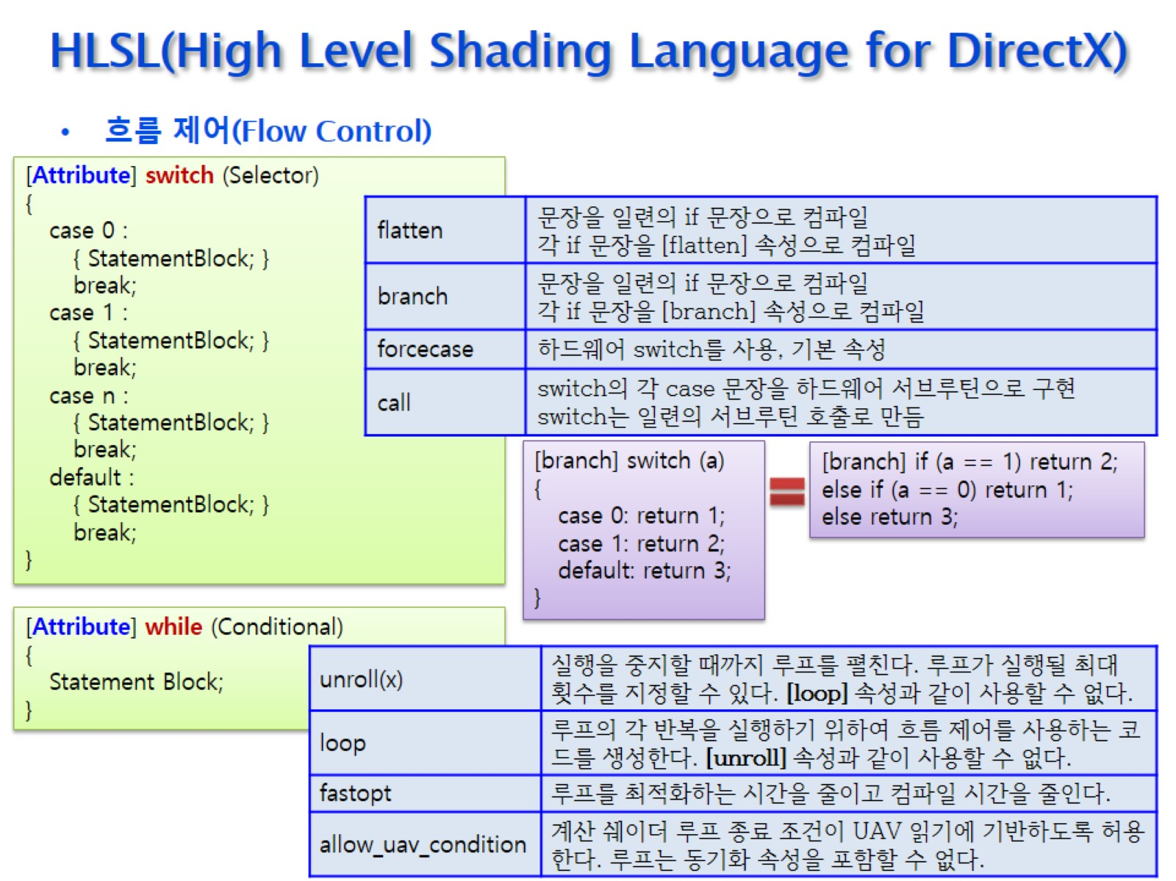
HLSL(High Level Shading Language for DirectX)

Slide 35
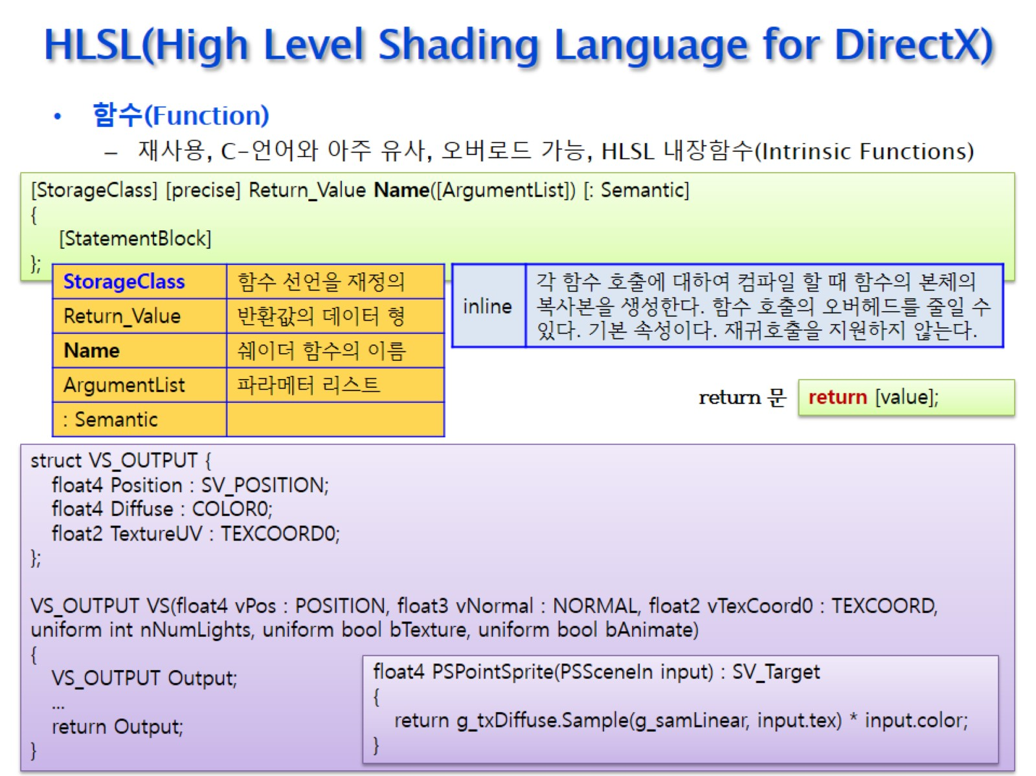
HLSL(High Level Shading Language for DirectX)

Slide 36
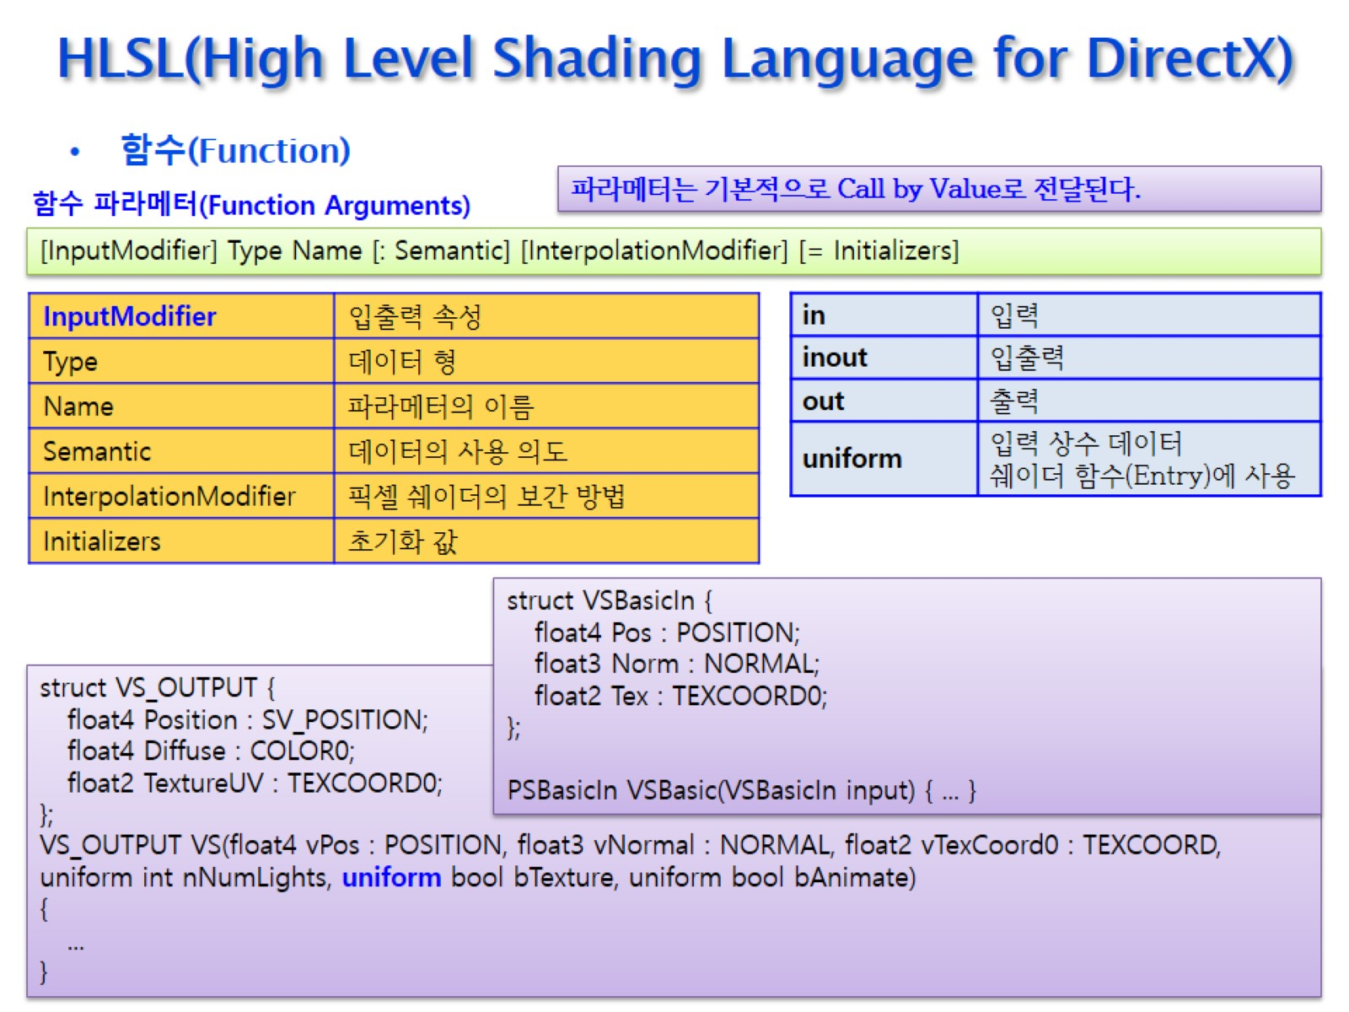
HLSL(High Level Shading Language for DirectX)

Slide 37
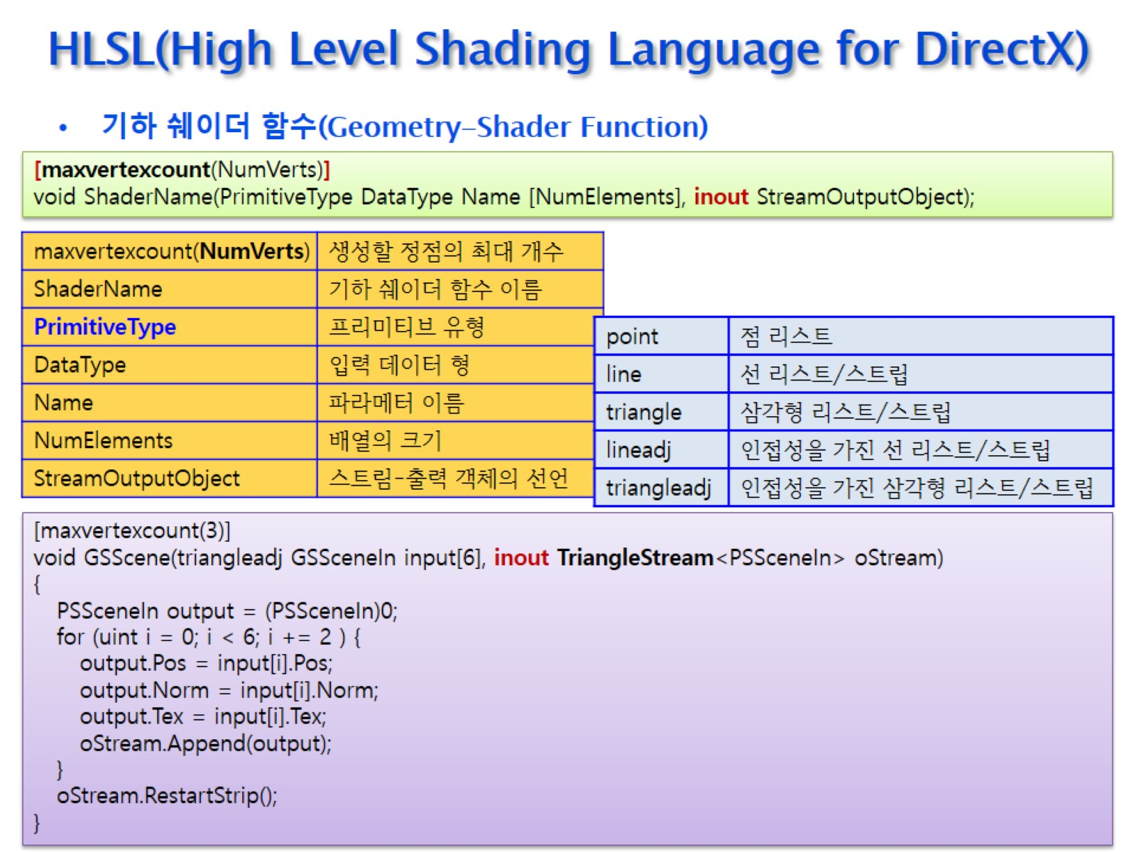
HLSL(High Level Shading Language for DirectX)

Slide 38
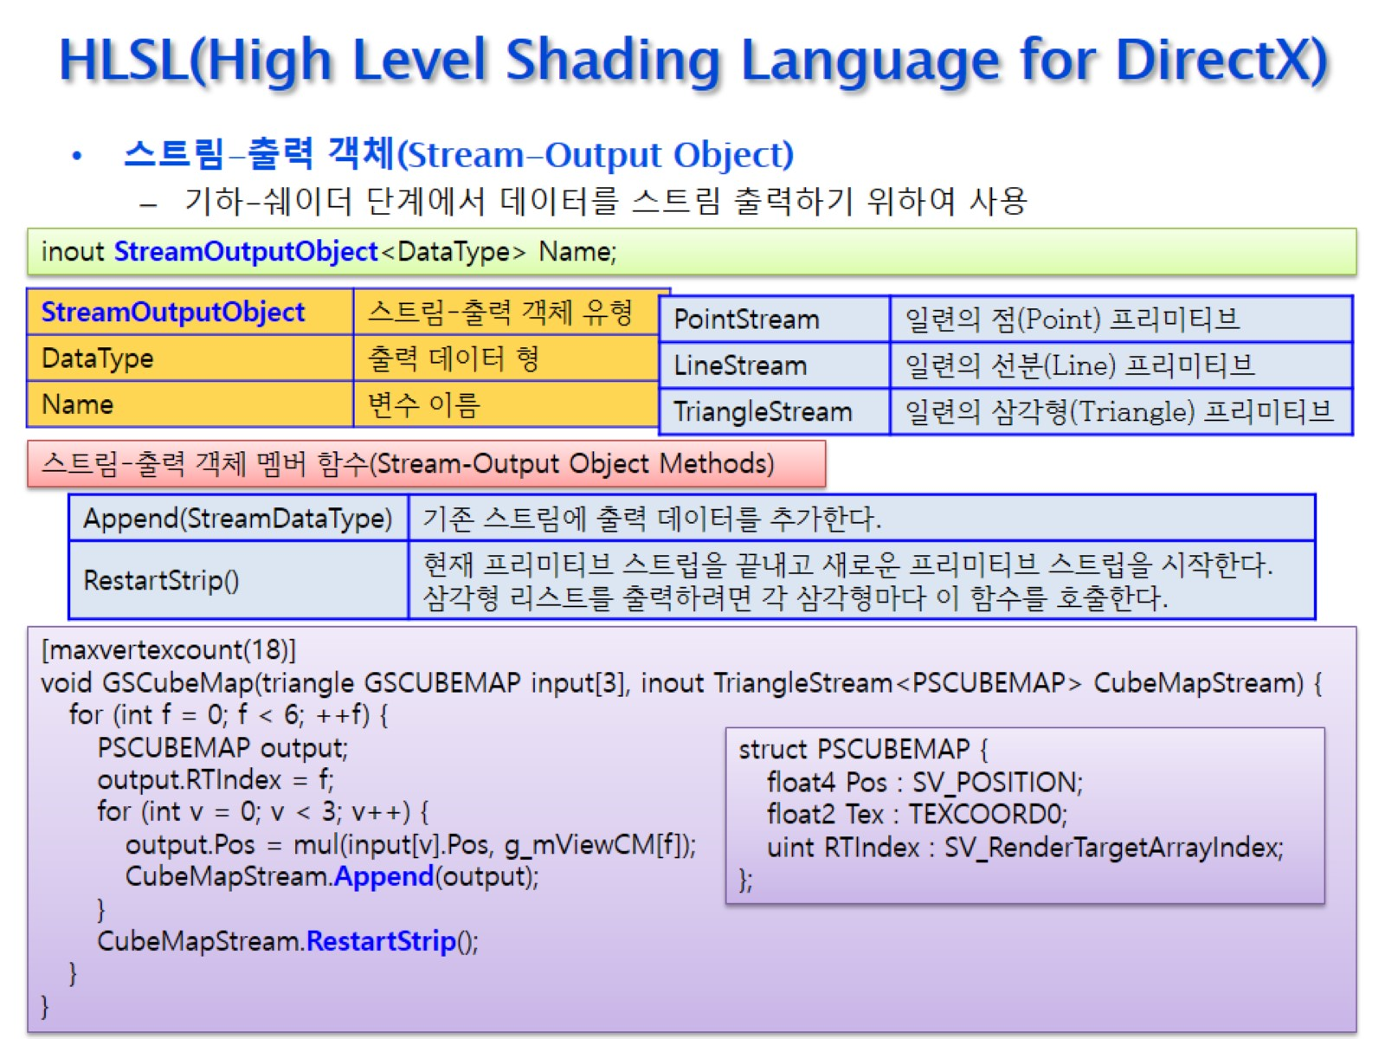
HLSL(High Level Shading Language for DirectX)

Slide 39
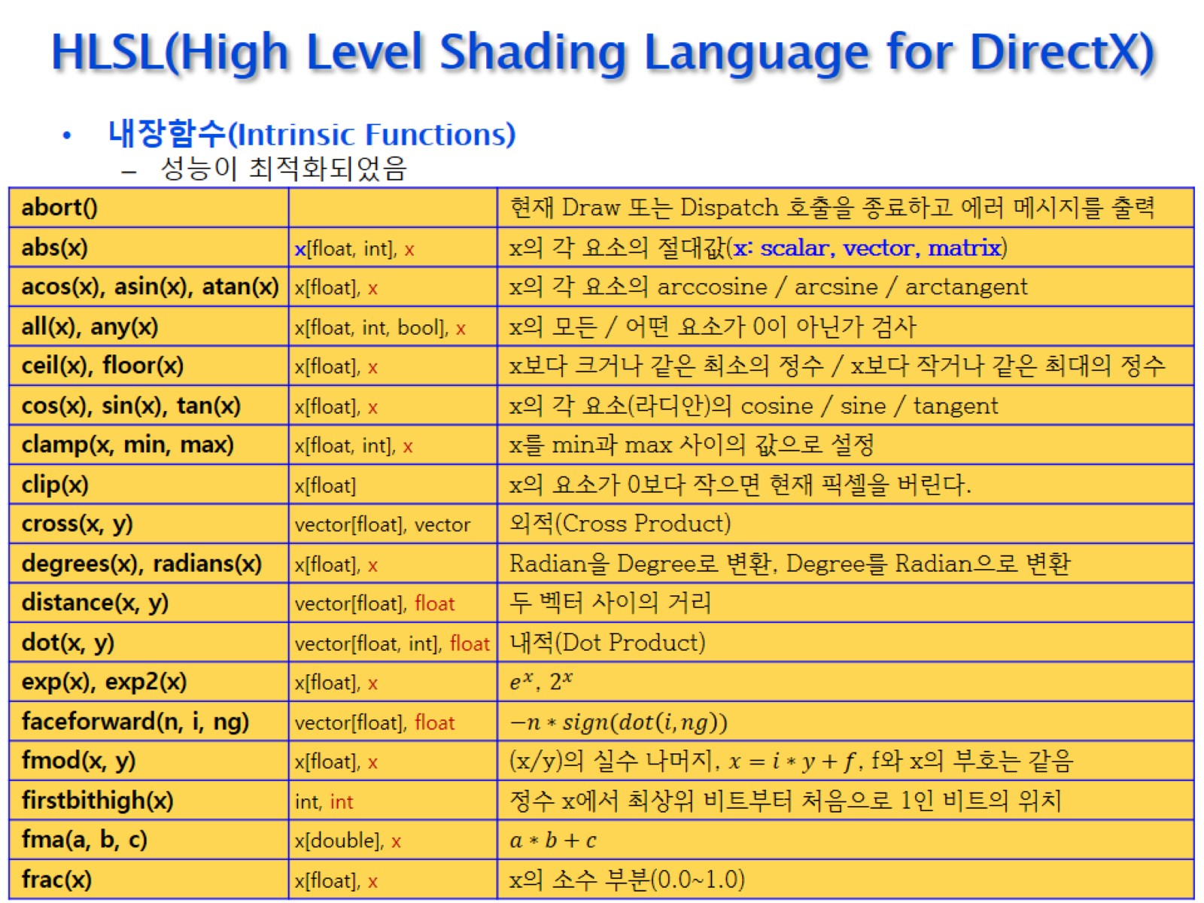
HLSL(High Level Shading Language for DirectX)

Slide 40
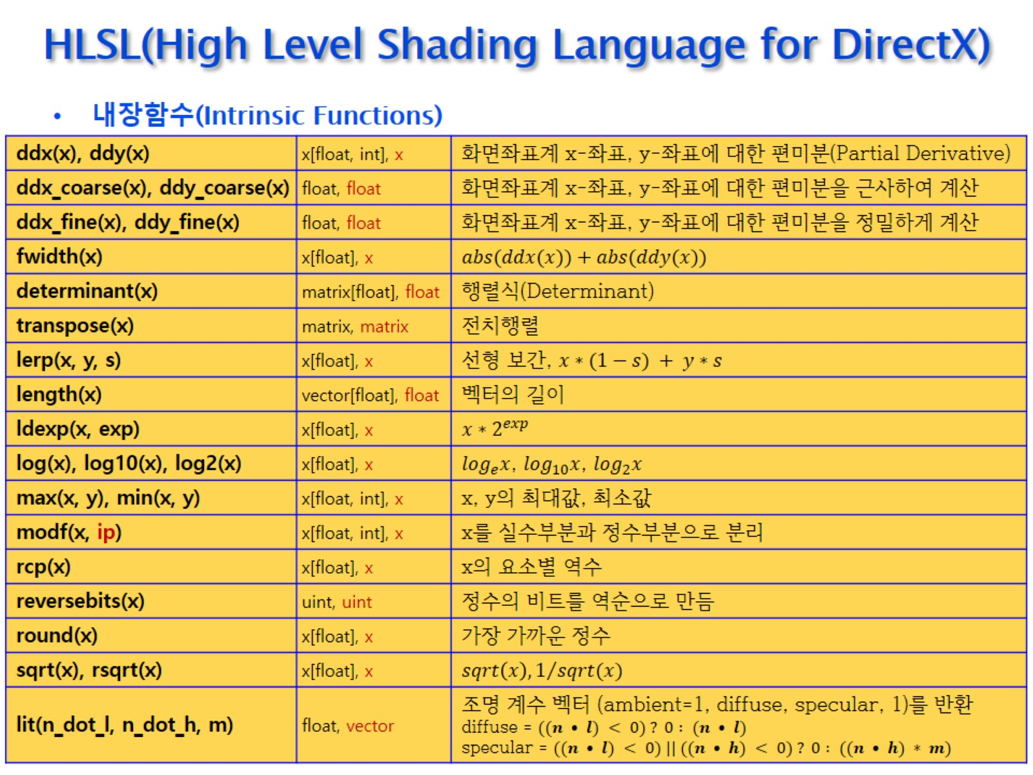
HLSL(High Level Shading Language for DirectX)

Slide 41
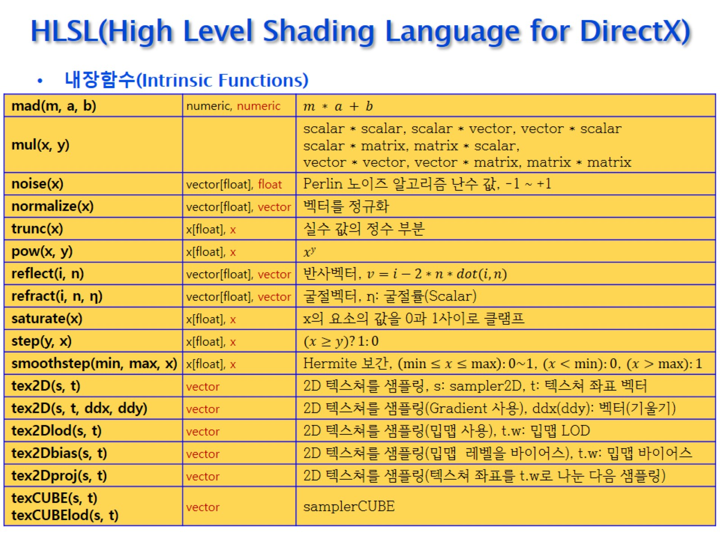
HLSL(High Level Shading Language for DirectX)

Slide 42
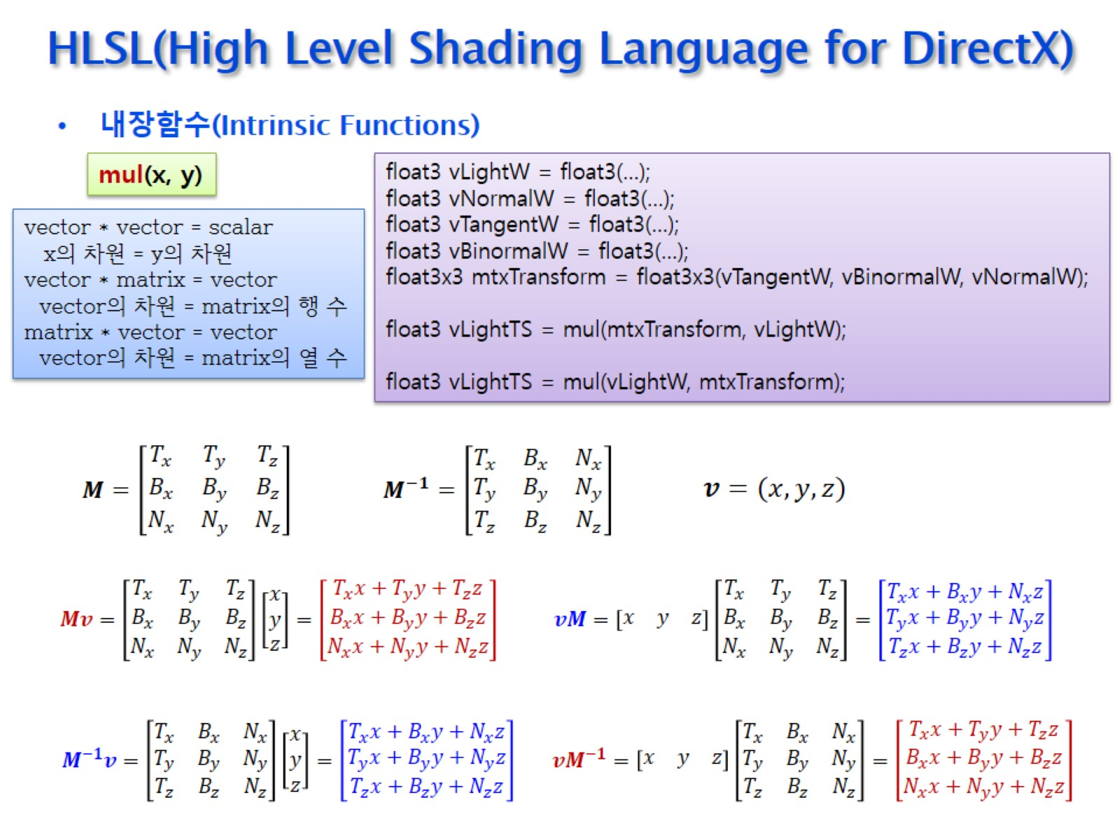
HLSL(High Level Shading Language for DirectX)

Slide 43
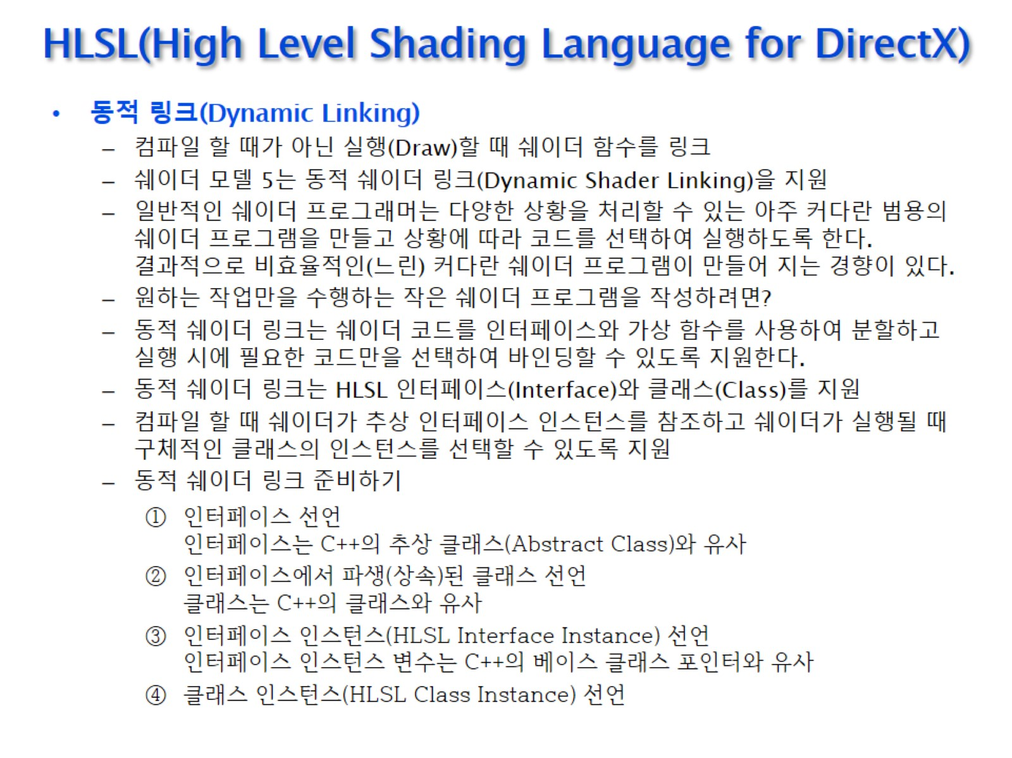
HLSL(High Level Shading Language for DirectX)

Slide 44
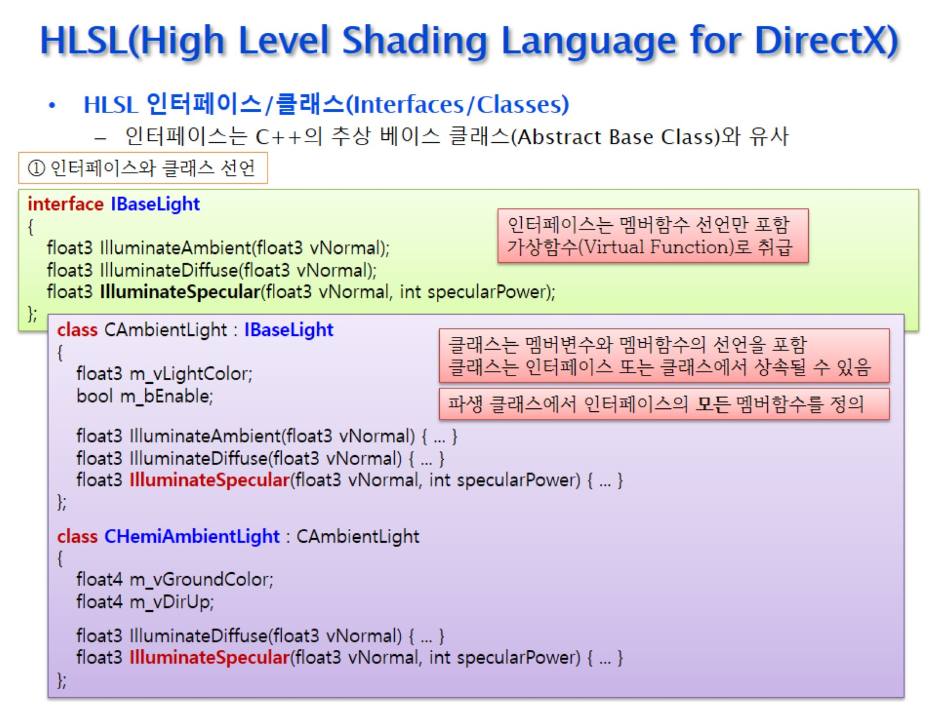
HLSL(High Level Shading Language for DirectX)

Slide 45
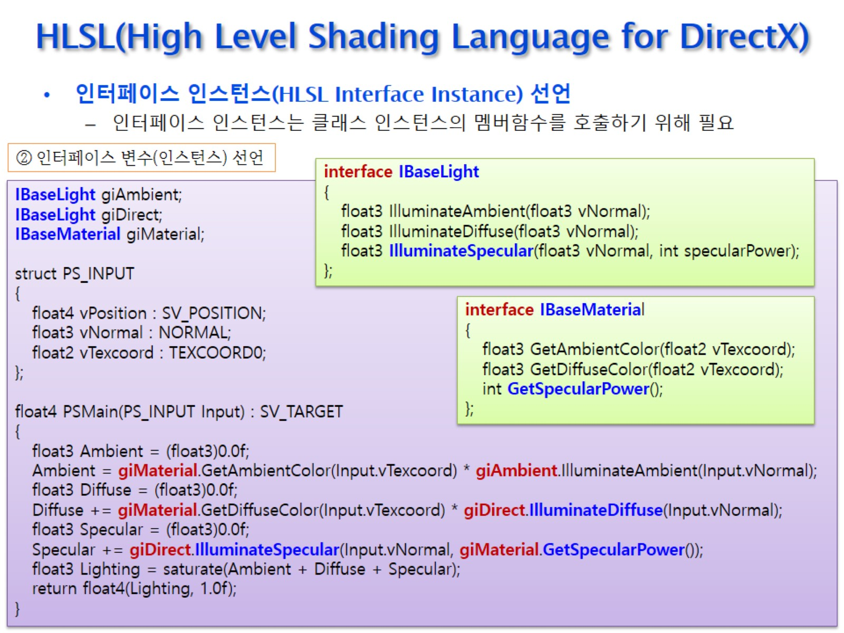
HLSL(High Level Shading Language for DirectX)

Slide 46
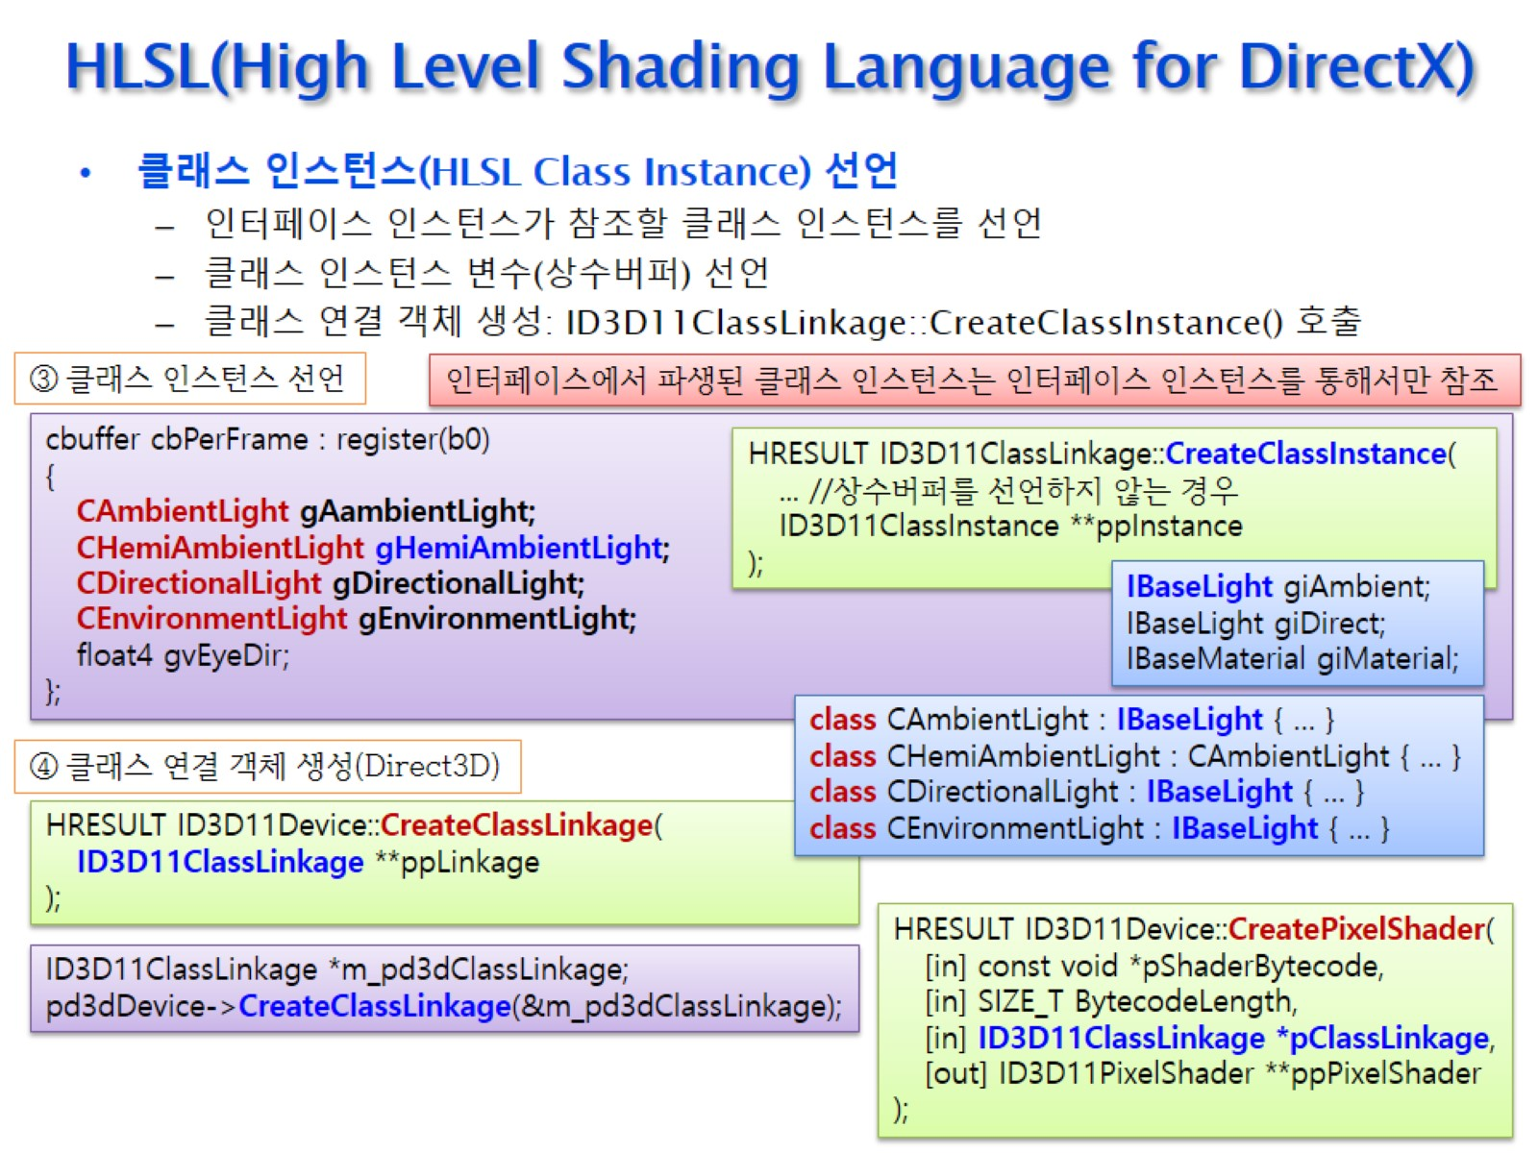
HLSL(High Level Shading Language for DirectX)

Slide 47
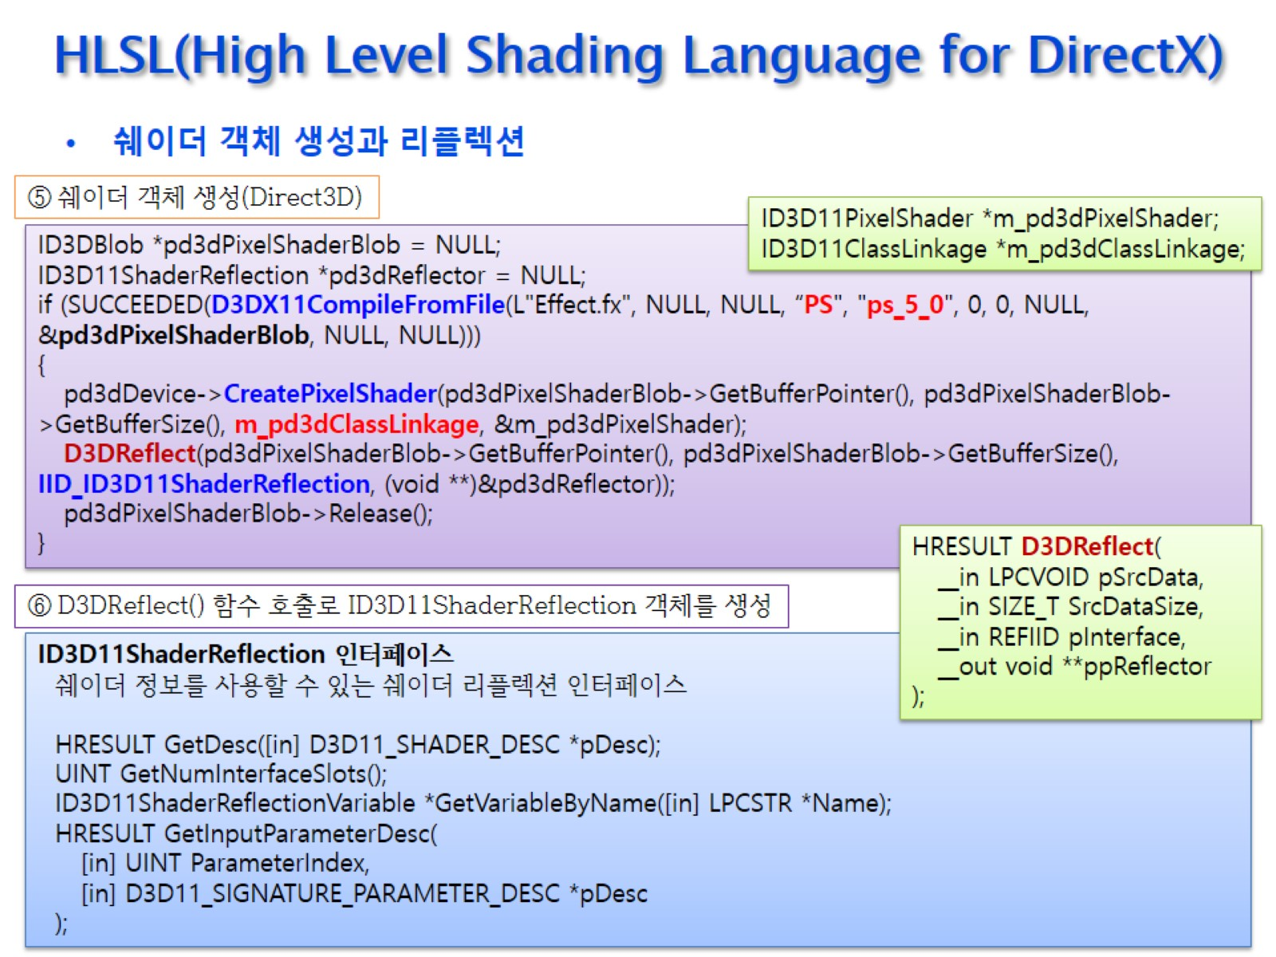
HLSL(High Level Shading Language for DirectX)

Slide 48
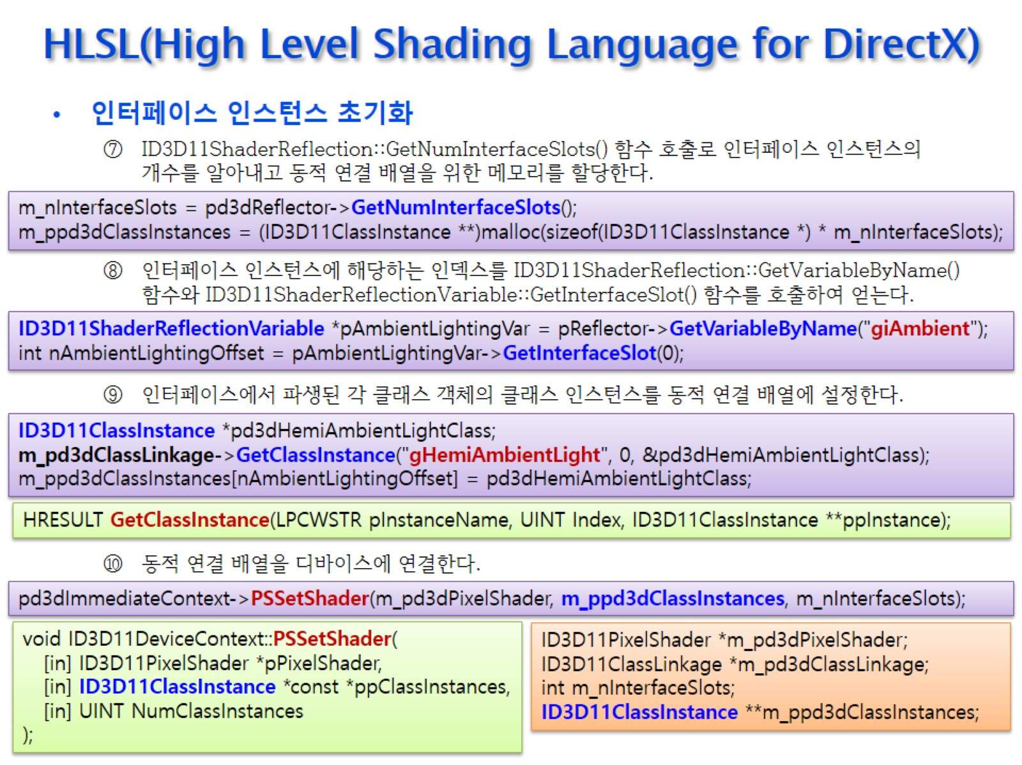
HLSL(High Level Shading Language for DirectX)

Slide 49
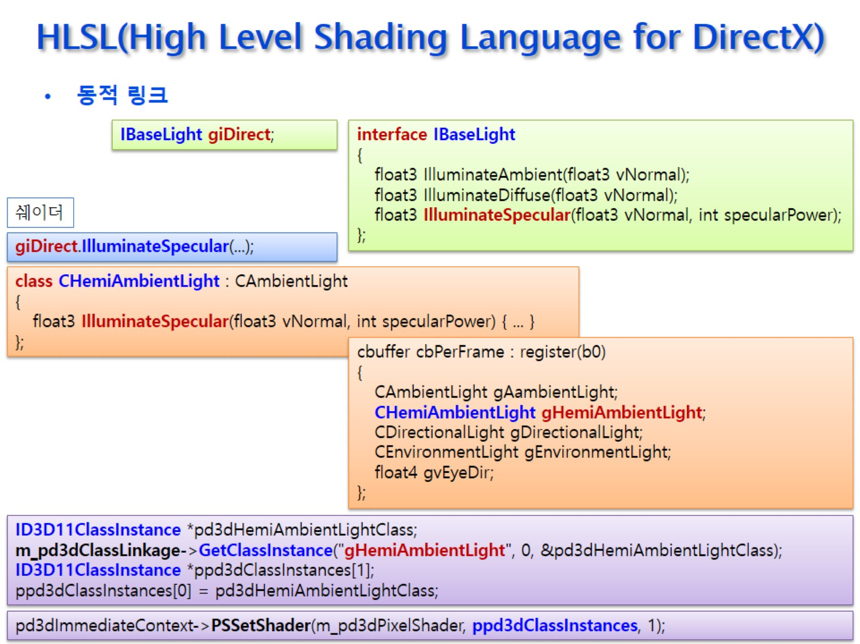
HLSL(High Level Shading Language for DirectX)

Slide 50
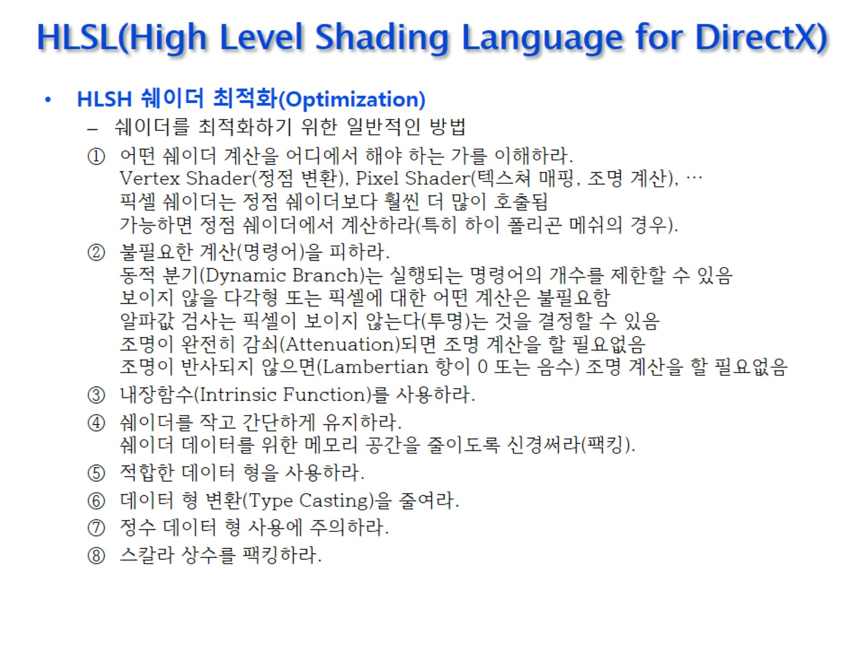
HLSL(High Level Shading Language for DirectX)

Slide 51

HLSL(High Level Shading Language for DirectX)

Slide 52

HLSL(High Level Shading Language for DirectX)

Slide 53

HLSL(High Level Shading Language for DirectX)

Slide 54

HLSL(High Level Shading Language for DirectX)

Slide 55

HLSL(High Level Shading Language for DirectX)

Slide 56

HLSL(High Level Shading Language for DirectX)

Slide 57

HLSL(High Level Shading Language for DirectX)

